Slide 1
Computer Graphics Rendering
Lecture 9: Path tracing
Kartic Subr

Slide 2
I spent too long on CW1…
- I spent too much time on little details
- I should have hacked it together
- I should have focused on completing easy tasks from the marking scheme
- I should have started earlier

Slide 3
Recap: MC integration and importance sampling

Slide 4
Incident or incoming radiance at x
$$n$$
$$x$$

Slide 5
Differential irradiance at infinitesimal patch
$\text{d}E_{i}$ = $L(x, ω_{i})\text{ (}ω_{i}\text{.}\text{n}\text{) }\text{d}ω_{i}$
$$n$$
radiance
$$L(x, ω_{i})$$
W m⁻²
differential irradiance at x,
due to one incident ray
W m⁻² Sr⁻¹
$$\text{d}ω_{i}$$
$$\text{dA}$$
$$x$$

Slide 6
Outgoing radiance along a direction
radiance
$$L(x, ω_{i})$$
$$L(x, ω_{o})$$
$$\text{d}ω_{i}$$
$$\text{dA}$$
$$x$$

Slide 7
Linear optics: reflected radiance ∝ irradiance
d$L\left(x, ω_{o}\right)$ = $ρ(ω_{i},ω_{o})$ $\text{d}E_{i}$

Slide 8
Constant of proportionality is a function!
d$L\left(x, ω_{o}\right)$ = $ρ(ω_{i},ω_{o})$ $\text{d}E_{i}$
Constant for a given pair of incident-outgoing directions
Determines appearance of opaque materials
Bidirectional Reflectance Distribution Function (BRDF)-

Slide 9
BRDF slice per incident direction
$$ω_{i}$$
$ρ(ω_{i},:)$
more light along
direction of specular reflection

Slide 10
BRDF slice per incident direction
$$ω_{i}$$
$ρ(ω_{i},:)$
more light along
direction of specular reflection

Slide 11
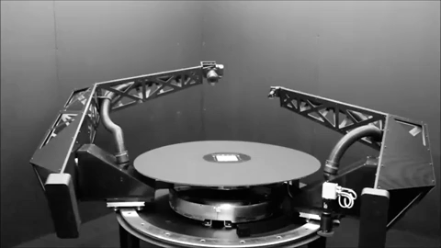
BRDF measurement - gonioreflectometer
tabulate 4D measured values?
[robotae]
http://www.cs.cmu.edu/afs/cs/academic/class/15462-f09/www/lec/lec9.pdf

Slide 12
phase functions
commonly used material models
BSDF
BSSRDF
SvBRDF

Slide 13
Reflection: multiple incident rays
$L\left(x, ω_{o}\right)$ = $\sum_{i}{ ρ(ω_{i},ω_{o}) \text{d}E_{i}}$
contributions for different directions weighted by BRDF

Slide 14
Add emission from surface at x
$L\left(x, ω_{o}\right)$ =$L_{e}\left(x, ω_{o}\right)$ + $\sum_{i}{ ρ(ω_{i},ω_{o}) \text{d}E_{i}}$
contributions for different directions weighted by BRDF

Slide 15
In the limit …
$L(x, ω_{o})$ = $L_{e}\left(x, ω_{o}\right)$. + $\int_{H^{2}}^{ }{ ρ\left(ω_{i},ω_{o}\right) L(x, ω_{i}) \text{(}ω_{i}\text{.}\text{n}\text{) }\text{d}ω_{i}}$
surface emission
hemisphere
BRDF
incident radiance
cosine dependence
… the rendering equation
[Kajiya 86]

Slide 16
The rendering equation
[Kajiya 86] https://dl.acm.org/citation.cfm?id=15902

Slide 17
Contrast with Whitted raytracing
How to get ‘soft’ shading and lighting effects?

Slide 18
Solving the rendering equation

Slide 19
Estimate integrals recursively
1) Sample hemisphere at last bounce to camera

Slide 20
Estimate integrals recursively
1) Sample hemisphere at last bounce to camera
2) Trace each sample ray back to intersection

Slide 21
Estimate integrals recursively
1) Sample hemisphere at last bounce to camera
2) Trace each sample ray back to intersection
3) Sample those hemispheres
4) Recurse until k bounces
5) Use recursion results to estimate radiance

Slide 22
Estimate integrals recursively
k bounces with n samples each
= n^k samples per pixel
e.g. 8000 spp if n = 20 and k = 3

Slide 23
Let there be blur!
Numerical integration
aperture
time
materials
penumbra
Distributed ray tracing [Cook et al 1984]

Slide 24
Whitted ray tracing – ray tree
primary ray
1 bounce
reflected ray
refracted ray
light ray
2 bounces
3 bounces : 3^3 = 27 rays

Slide 25
Distributed ray tracing – ray tree
primary ray
estimating integral by averaging
1 bounce
2 bounces
3 bounces : 10^3 = 1000 rays

Slide 26
Helps, but expensive!

Slide 27
Better way to solve the rendering equation?
estimating integral by averaging
path tracing [Veach98]

Slide 28
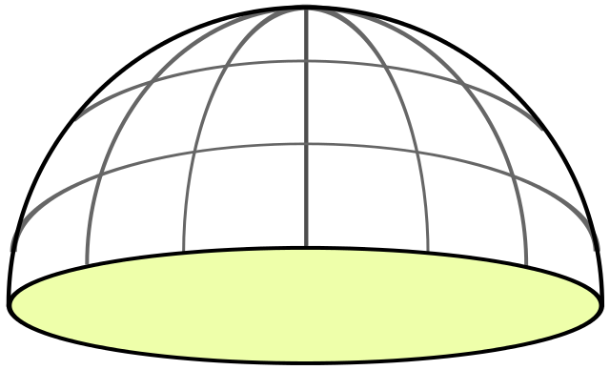
Random sampling at each level
x₁ drawn randomly in [0,1] x [0,1]

Slide 29
Random sampling at each level
x₂ drawn randomly in [0,1] x [0,1]

Slide 30
When to terminate?
x_{d} drawn randomly in [0,1] x [0,1]
?

Slide 31
When to terminate path?
Fixed depth d
When radiance is low
threshold
randomly
Russian roulette

Slide 32
More bounces? depends on scene
2 bounces
9 bounces
https://twitter.com/DisneyAnimation/status/1146085535057715200

Slide 33
Path tracing each pixel - overview
pixel area
2D
aperture
2D
2d+5 dimensions
exp. time
1D
bounces
d*2D
pixel value = average radiance
(over sampled paths)

Slide 34
Path tracing each pixel - overview
pixel area
2D
aperture
2D
2d+5 dimensions
N samples
per pixel
exp. time
1D
bounces
d*2D
pixel value = average radiance
(over sampled paths)

Slide 35
Path tracing: mapping samples to paths
pixel area
2D
aperture
2D
2d+5 dimensions
N samples
per pixel
exp. time
1D
map sample to path
& record radiance
randomly sample
the hypercube
bounces
d*2D
pixel value = average radiance
(over sampled paths)

Slide 36
Path tracing: mapping samples to paths
pixel area
2D
aperture
2D
2d+5 dimensions
N samples
per pixel
exp. time
1D
bounces
d*2D
randomly sample
the hypercube
map sample to path
& record radiance
pixel value = average radiance
(over sampled paths)

Slide 37
Path tracing - maths
pixel average radiance
pixel filter weighting
[https://jo.dreggn.org/path-tracing-in-production/2019/index.html

Slide 38
http://madebyevan.com/webgl-path-tracing/

Slide 39
Importance sampling paths

Slide 40
Importance sampling paths

Slide 41
Importance sampling paths

Slide 42
Mid-course summary…
content
assessment

Slide 43
This course so far …
content
assessment

Slide 44
This course so far …
content
assessment
maths
physics
self-learning
programming

Slide 45
This course so far …
content
assessment
maths
physics
self-learning
programming

Slide 46
This course so far …
content
assessment
self-learning
maths
physics
programming

Slide 47
This course
v 1.0 (2007, Columbia University, NY)
Evolved
current trends/needs (e.g. online resources, LLMs)
mixture of fun + skills (awareness vs career in CG)
assessment and learning are not independent!

Slide 48
Feedback/appraisal
Piazza (anonymous)
email me (personal)
Love the course? Consider nominating me …
(will open in Sem 2)
https://www.eusa.ed.ac.uk/whatson/awards/teachingawards

