Slide 1
Computer Graphics
Autumn 2024, Lecture 5: Raytracing
Kartic Subr

Slide 2
Raytracing?

Slide 3
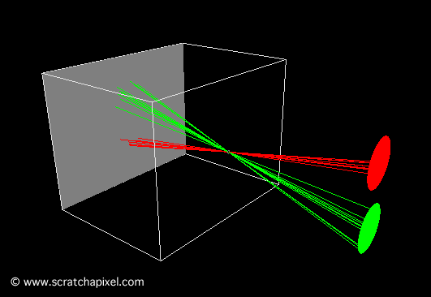
Pinhole camera
Ibn al-Haytham (965-1040 AD)

Slide 4
Albrecht Dürer,
1525
Computer Graphics: Principles and Practice, Third Edition by Kurt Akeley, Steven K. Feiner, James D. Foley, David F. Sklar, Morgan McGuire, Andries van Dam, John F. Hughes. See this video

Slide 5
Johannes Vermeer 17th Century

Slide 6
Vermeer’s comparator mirror

Slide 7
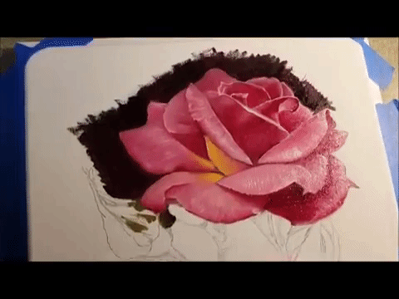
Vermeer’s comparator mirror
https://youtu.be/deAK0oV6Vt8

Slide 8
The next 200 years …

Slide 9
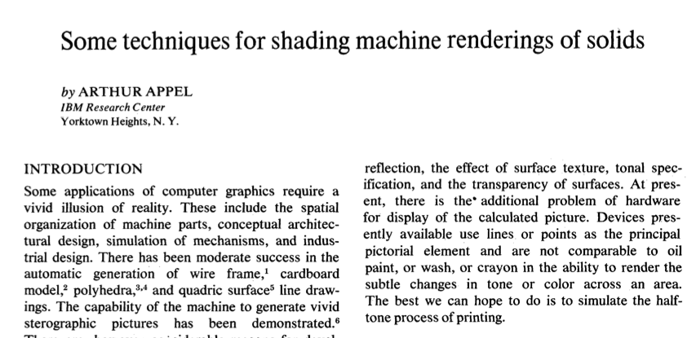
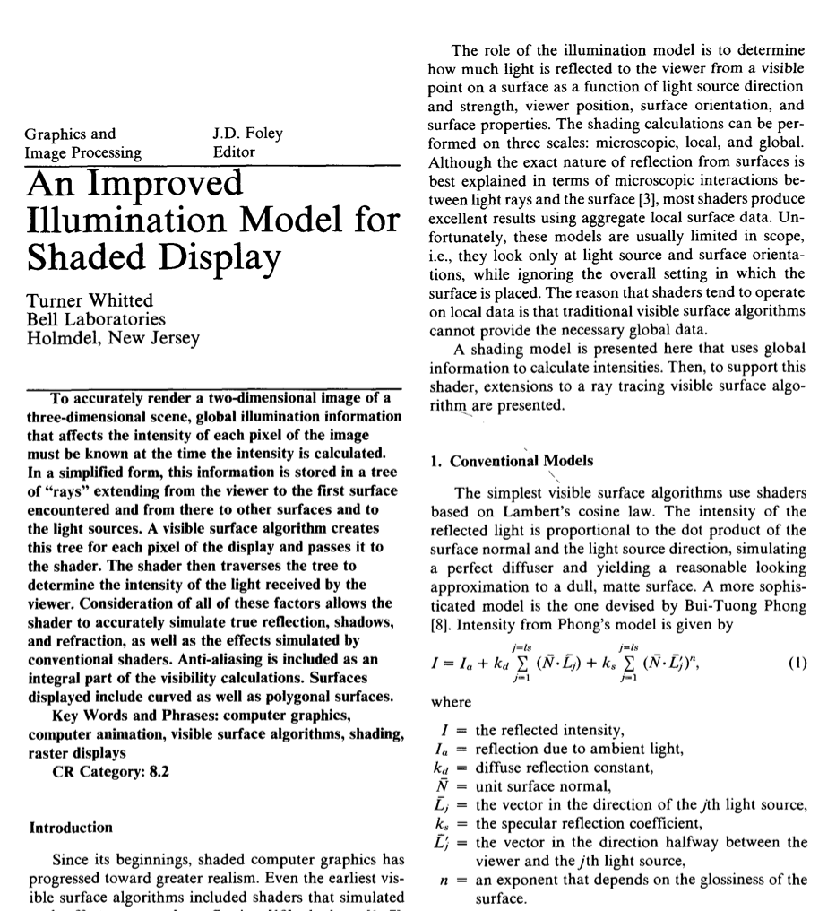
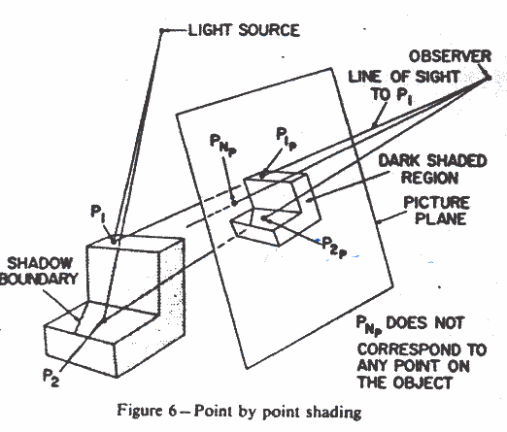
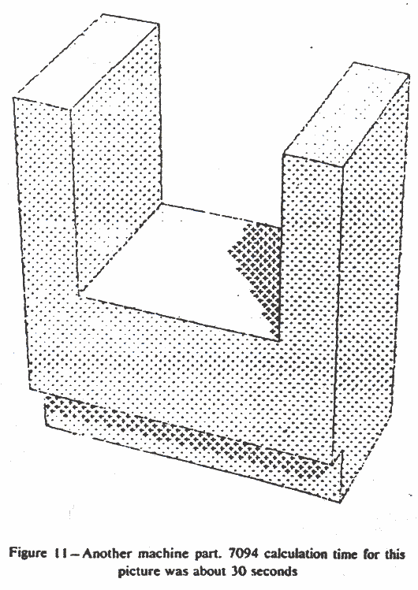
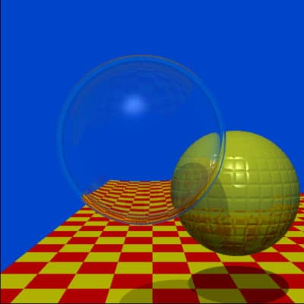
1968
1979

Slide 10
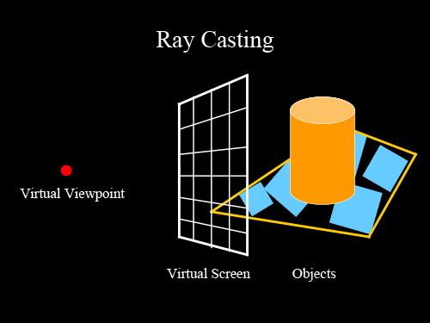
Ray casting
image credit
http://studiomaven.org/Context__Overview_of_Ray-Traced_Rendering.html

Slide 11
Ray casting
for each pixel p
cast ray r through p into the scene
test if r intersects objects in the scene
if yes
find closest intersection point h
shade h
else
return background colour (black)
endif
1
2
3
image credit
http://studiomaven.org/Context__Overview_of_Ray-Traced_Rendering.html

Slide 12
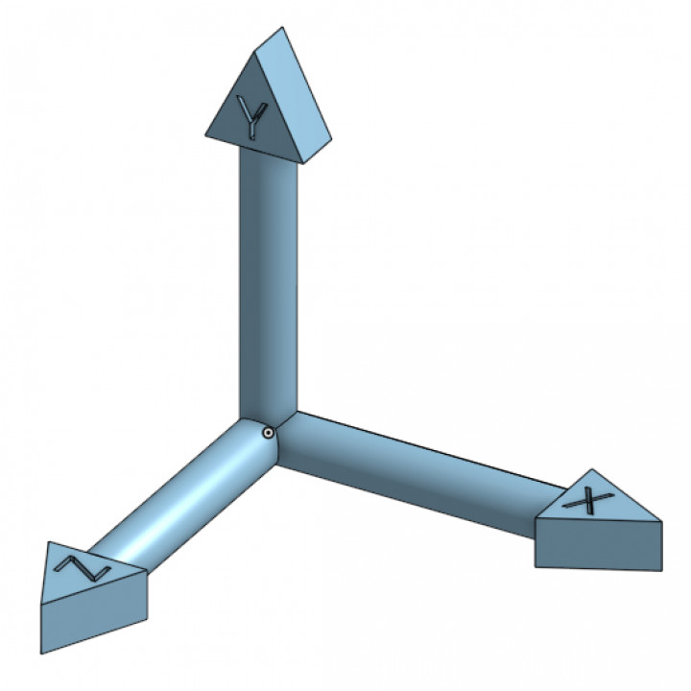
Ray casting
1
https://www.americanscientist.org/article/a-pixel-is-not-a-little-square

Slide 13
Ray casting
1
https://graphicscompendium.com/raytracing/02-camera

Slide 14
Ray intersection
2
p
r
intersection point ?

Slide 15
Ray – plane intersection

Slide 16
Ray – plane intersection

Slide 17
Vectors - recap

Slide 18
Ray – plane intersection

Slide 19
Ray – plane intersection
https://www.youtube.com/watch?v=gsZiJeaMO48

Slide 20
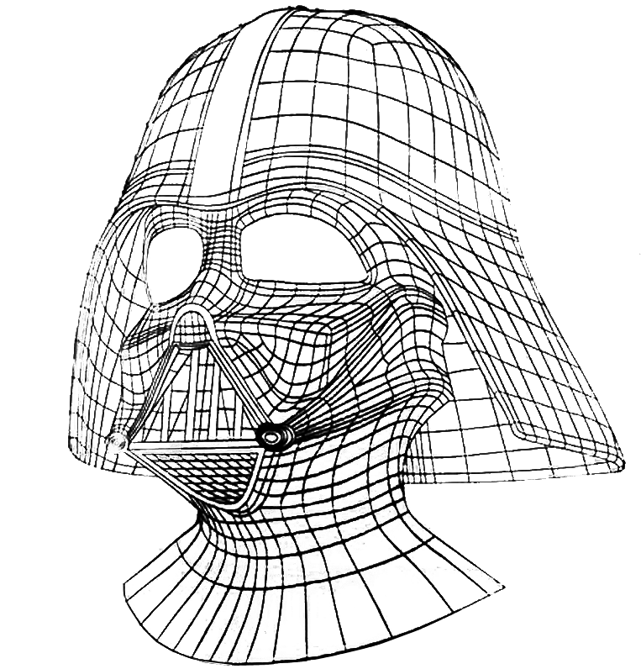
Computation: test many objects
hit!
missed

Slide 21
Speed up testing many objects?
Discuss with your neighbour(s) and propose strategies

Slide 22
Acceleration data structures
grids
- uniform
- adaptive e.g. octree
bounding box
- simple
- concave objects?
arbitrary bounding volume
- ‘tight’ but more tests
- concave objects?

Slide 23
Acceleration technique

Slide 24
Acceleration: bounding volume hierarchy

Slide 25
Acceleration: bounding volume hierarchy
test ray at highest level
- recurse based on intersection result
Interested readers: slides

Slide 26
Video games: 0.5 billion rays per second!
60 frames per second
4K (UHD)
3840 x 2160
8.2 million pixels

Slide 27
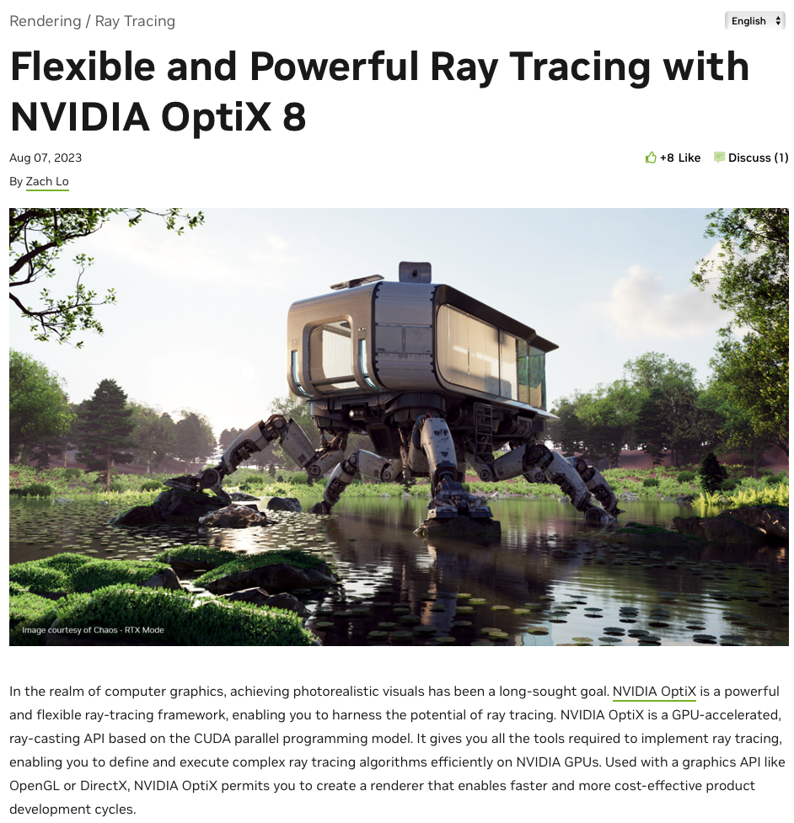
Ray intersection - GPU
https://developer.nvidia.com/blog/flexible-and-powerful-ray-tracing-with-optix-8/

Slide 28
Ray intersection - GPU
- Reduce computation time by executing parallel tests
Reduce number of tests via acceleration structures
trade off: building data structures and book-keeping
exploring data structures may not be easy or efficient

Slide 29
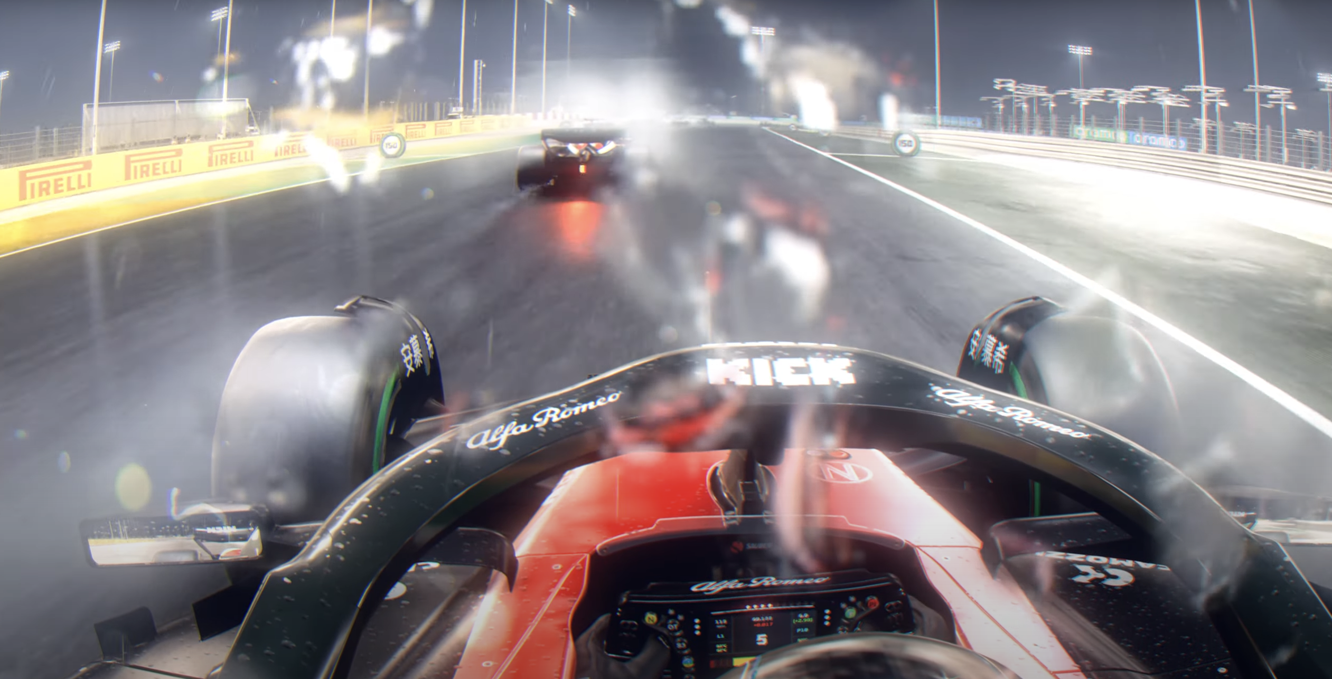
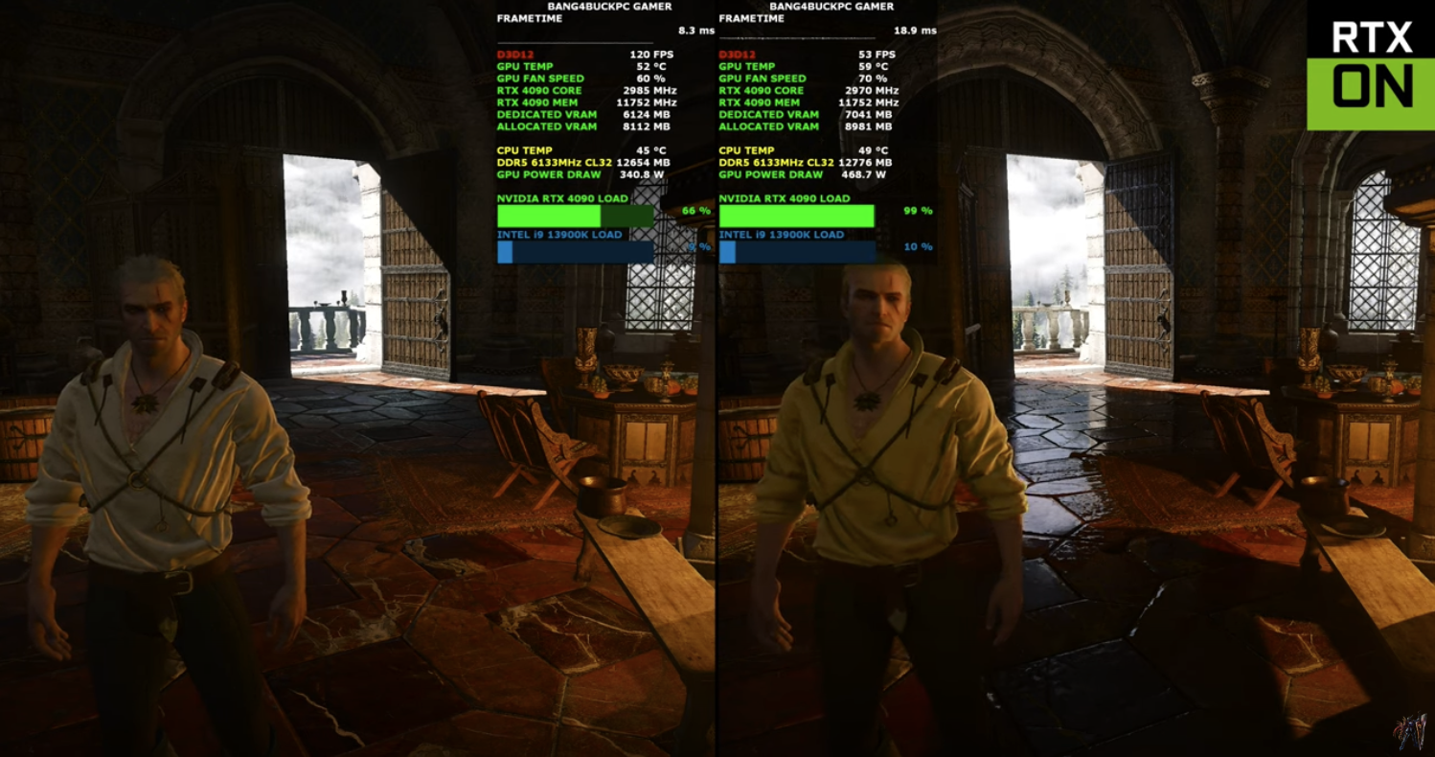
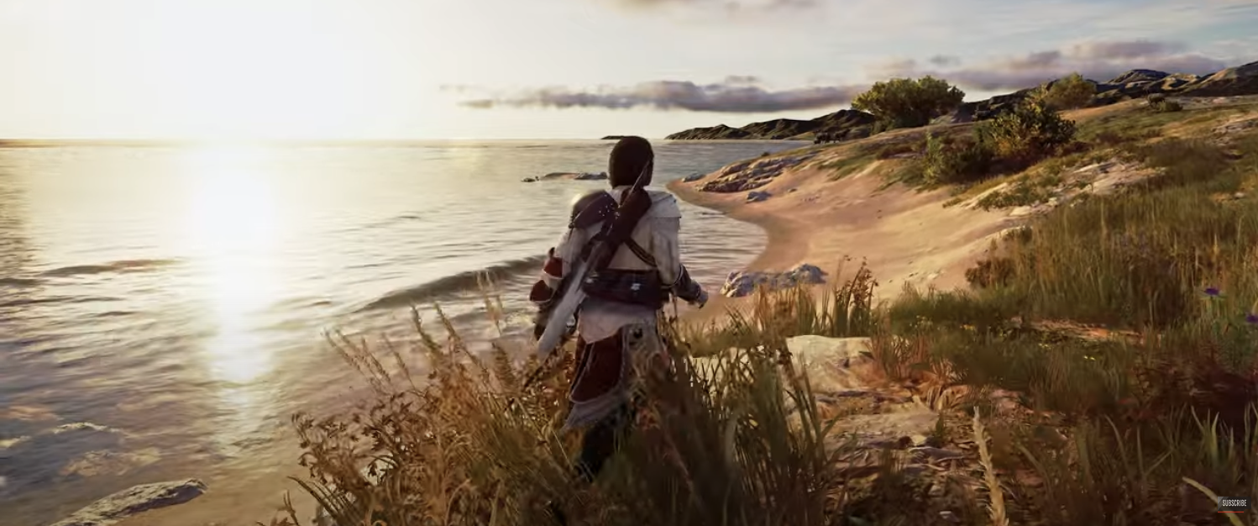
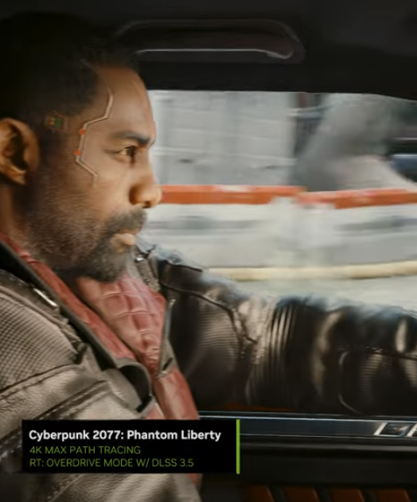
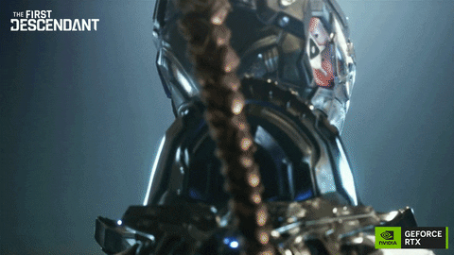
NVIDIA 4090
Some games with good visuals: here
~£1800, > 10b rays/s
https://www.youtube.com/watch?v=QHX8ktPFB9k
https://www.youtube.com/watch?v=dbSdvV_YU8U
https://www.youtube.com/watch?v=UZ_9-fklLns

Slide 30
Ray intersection
2
p
r
intersection point ?

Slide 31
Shading: How much light?
3

Slide 32
Approximation!

Slide 33
Shading: approximation
ambient light (constant)
+
diffuse
+
specular reflection of light

Slide 34
Phong shading
material property
ambient
diffuse
specular
light property
R is the mirror reflection direction
source:wikipedia

Slide 35
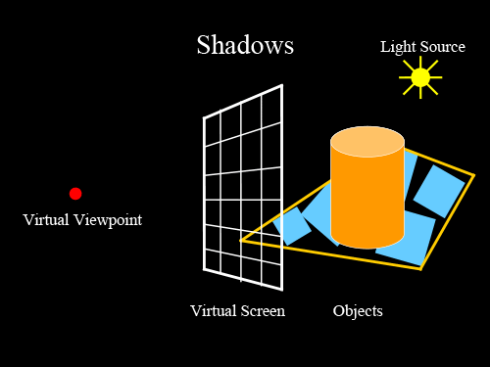
Shadows
image credit
http://studiomaven.org/Context__Overview_of_Ray-Traced_Rendering.html

Slide 36
Mirror (specular) reflection/refraction
image credit
http://studiomaven.org/Context__Overview_of_Ray-Traced_Rendering.html

Slide 37
Reflection

Slide 38
Resources
https://www.cs.utah.edu/~shirley/books/fcg2/rt.pdf
http://www.cs.utah.edu/~shirley/papers/rayedu.pdf
http://www.realtimerendering.com/raytracing/roundup.html
http://rtintro.realtimerendering.com/
https://benedikt-bitterli.me/tantalum/tantalum.html

