Slide 1
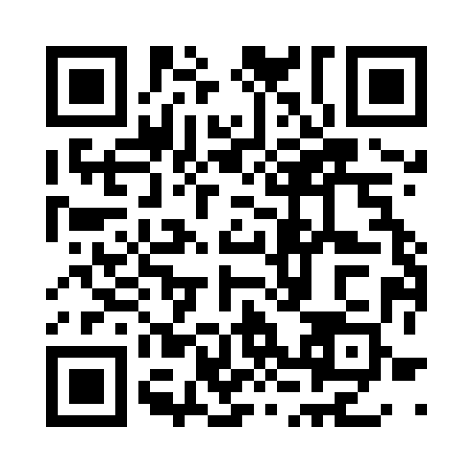
Welcome to Discover Careers
1 to 3 October 2024, 1pm to 6pm
120 employers
Different organisations each day,
across two floors
https://edin.ac/45e5DiL
Inspiring futures
Find out more on MyCareerHub

Slide 2
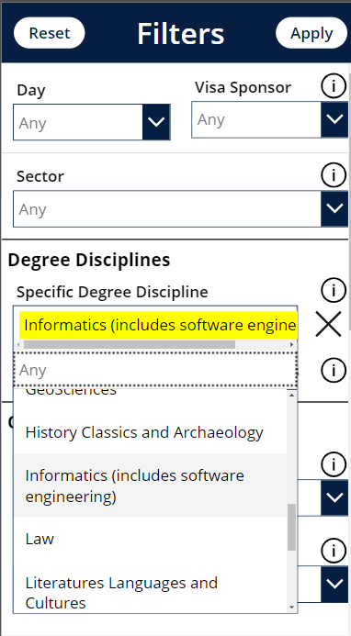
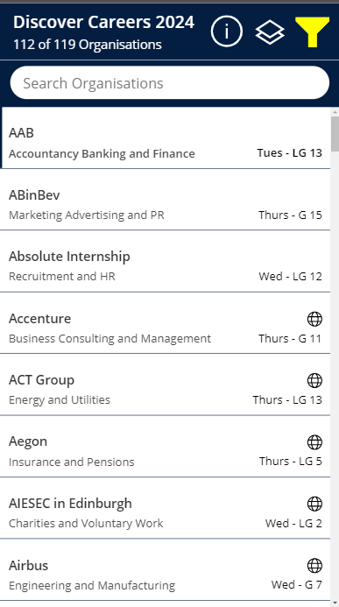
Why should you go?
112 of 119 Employers are specifically recruiting for Informatics Degree Disciplines (check the event guide)
94 Organisations have open graduate roles, 70 recruit for interns
Talk to recruiters about: Jobs, Workplace culture, Assessment Process, Tips to make you stand out
Need Help? Careers Service Staff on hand

Slide 3
Clarification about lenses from last week’s lecture

Slide 4
CW1 has been published

Slide 5
Computer Graphics
Lecture 4: Modelling
Kartic Subr

Slide 6
What is a model?

Slide 7
What is a model?
use (a system, procedure, etc.) as an example to follow or imitate.

Slide 8
materials
animation
lighting
geometry
textures

Slide 9
Search videos showing ‘effects breakdown’
https://www.youtube.com/watch?v=pTffQIFFYR8

Slide 10
Approaches to modelling
Artistic creation
maths
measurement

Slide 11
Approaches to modelling
Artistic creation
maths
measurement
Use physics
Repeated procedure
Analytical shapes (sphere)
3D scan
Photograph
Motion capture

Slide 12
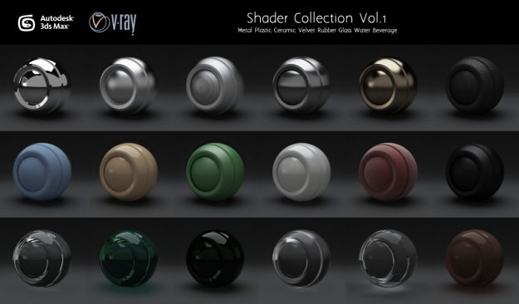
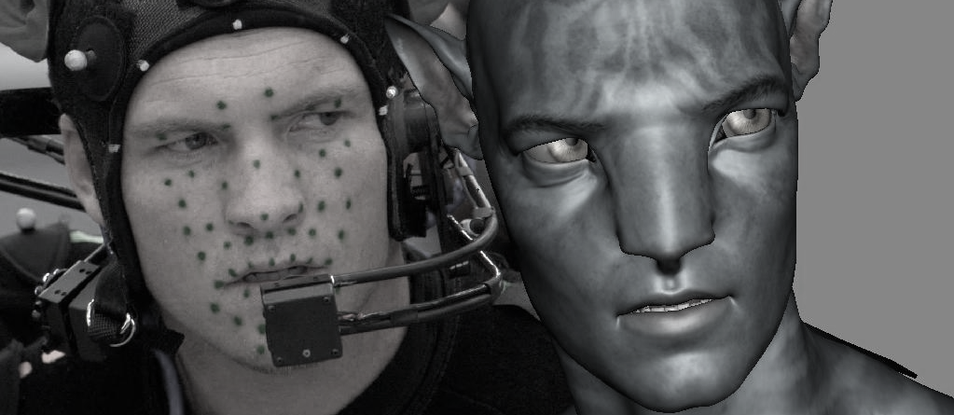
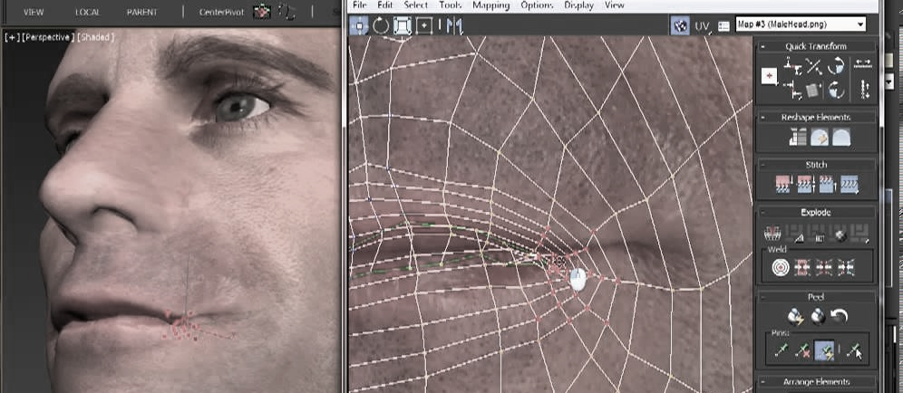
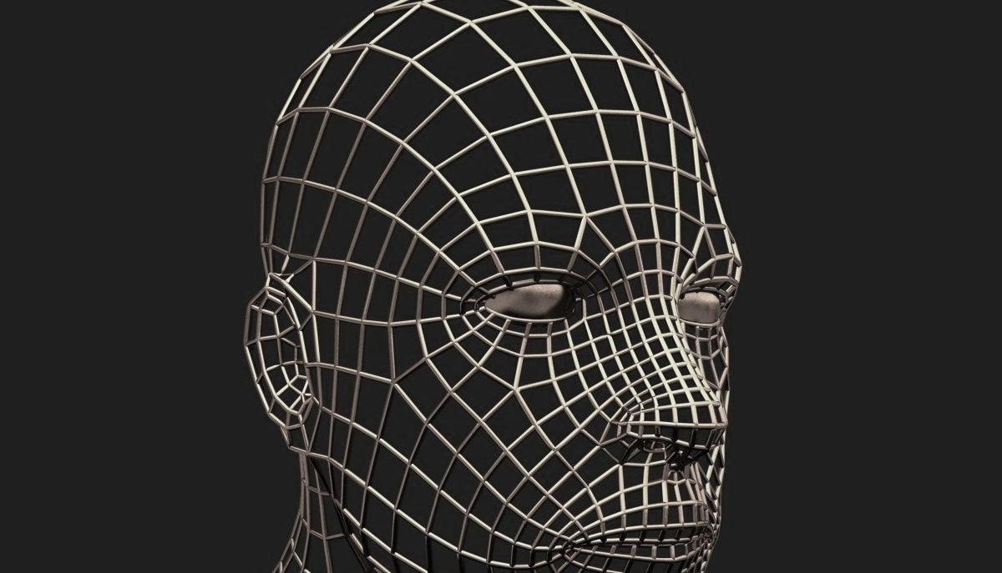
manually created models
artistic expression

Slide 14
measurement

Slide 16
mathematical models

Slide 17
3D shape representations
Implicit representation
Explicit representations
primitives
parametric

Slide 18
3D modelling – common approaches
constructive solid geometry
parametric surfaces
procedural modelling
https://www.cs.cmu.edu/~scoros/cs15869-s15/lectures/05-CSG_Procedural.pdf
http://www.inf.ed.ac.uk/teaching/courses/cg/lectures/slides16.pdf
https://www.cs.princeton.edu/courses/archive/spring03/cs426/lectures/16-procedural.pdf

Slide 19
Materials – common approaches
measured
parametric e.g. ggx, bssrdf
procedural modelling
more about this, later in the course …

Slide 20
Lighting

