Slide 1
Computer Graphics
Lecture 3: Cameras
Kartic Subr

Slide 2
Lec 2: Recap + Clarification

Slide 3
Lec 2: Recap + Clarification

Slide 4
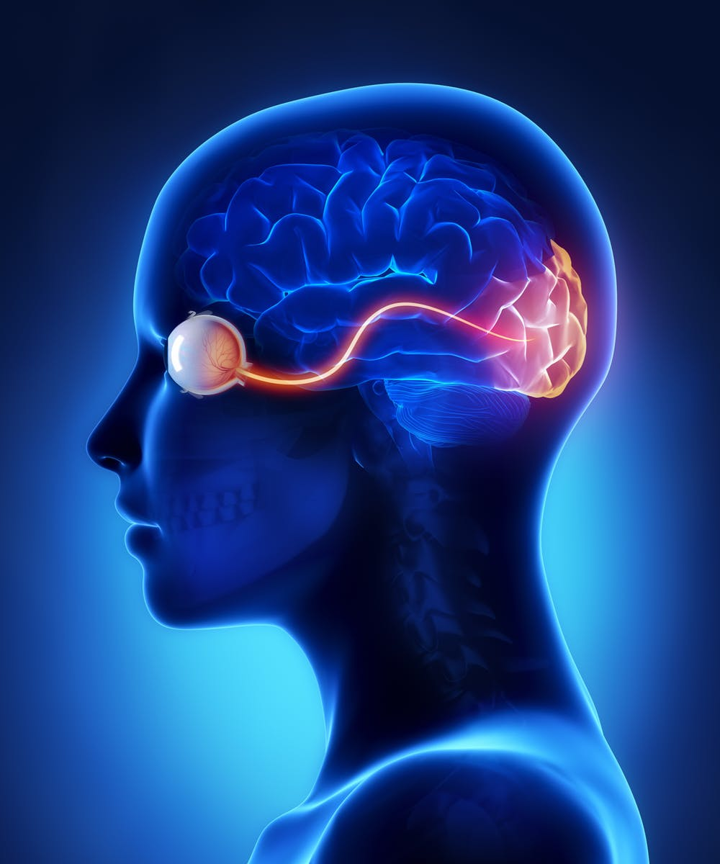
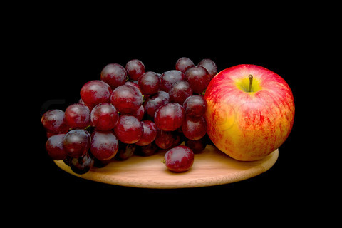
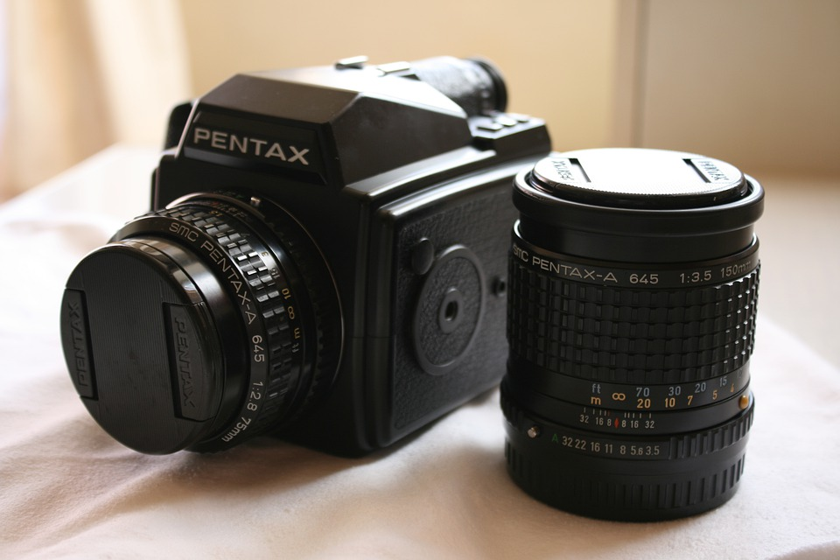
photography
rendering
Virtual

Slide 5
Cameras
Notes:
8 bits per channel
Store energy in the scene
View, color, energy mapping

Slide 6
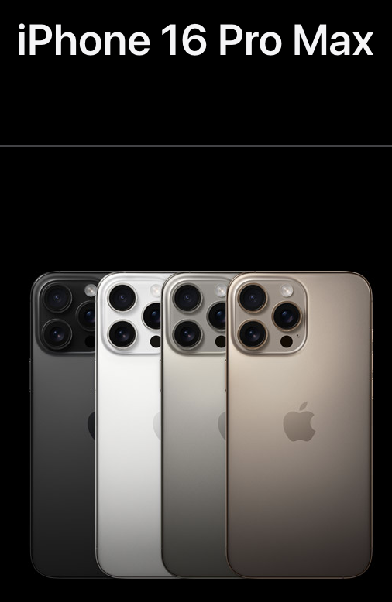
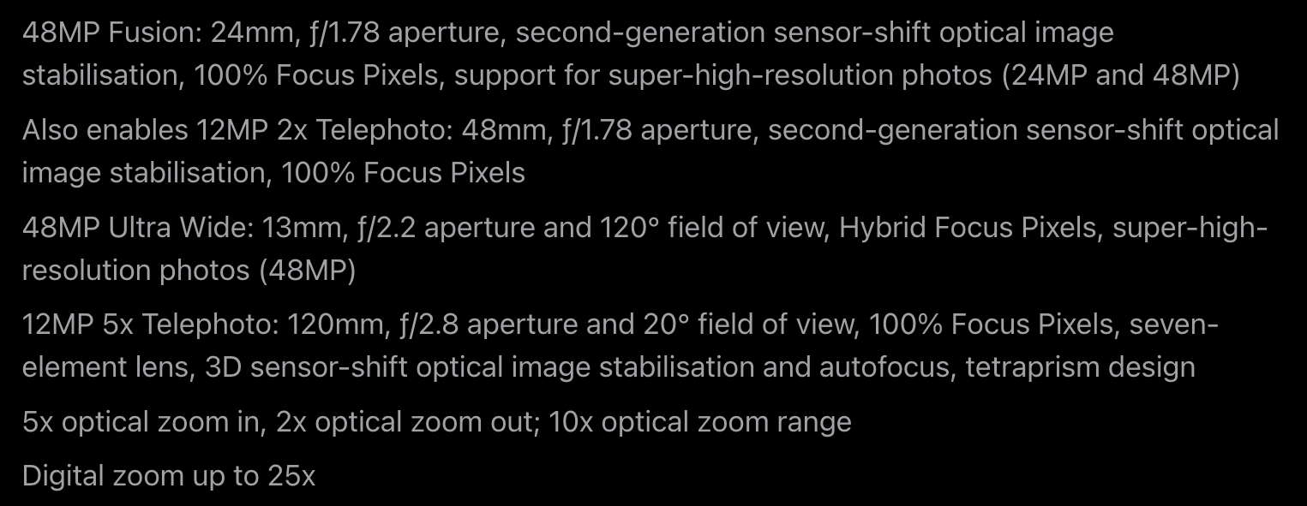
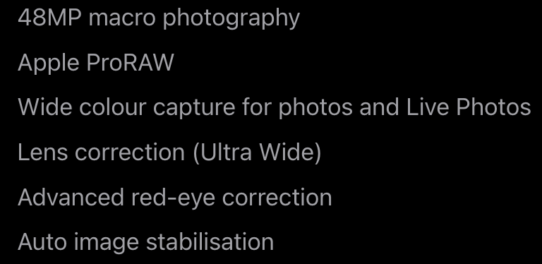

Slide 7
The pinhole camera
Notes:
8 bits per channel
Store energy in the scene
View, color, energy mapping

Slide 8
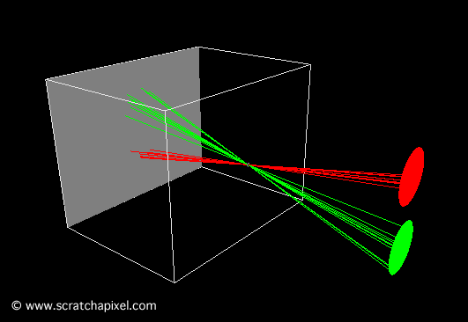
Pinhole camera
Ibn al-Haytham (965-1040 AD)

Slide 9
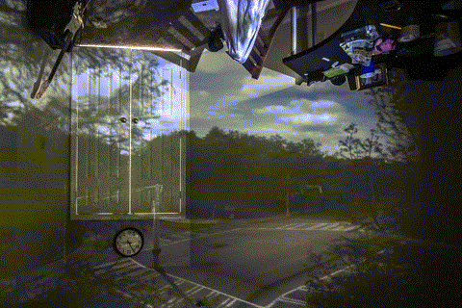
Camera Obscura
The making of …

Slide 10
Projection
Notes:
8 bits per channel
Store energy in the scene
View, color, energy mapping

Slide 11
What is a vector? e.g. 2D
u
v

Slide 12
What is a matrix? e.g. 2x2
a
b
c
d

Slide 13
Can we ‘operate on’ a vector?
a
b
u
au + bv
=
c
d
v
cu + dv

Slide 14
Can we ‘operate on’ a vector?
a
b
u
au + bv
=
c
d
v
cu + dv
operate
result

Slide 15
What operations can it achieve?
what can we say about the new shape?

Slide 16
What operation achieves translation?
?
u
c_{x}
+
v
0

Slide 17
Can we achieve this with a matrix?
?

Slide 18
Can we achieve this with a matrix?
?
Ans: Not with a 2x2 matrix

Slide 19
What if we add a dimension?
a
b
c
u
d
e
f
v
g
h
i
1
matrix is 3x3
still 2D vectors

Slide 20
Now, translation is possible as an operation
0
0
c_{x}
u
u + c_{x}
0
0
c_{y}
v
=
v + c_{y}
0
0
1
1
1

Slide 21
Homogeneous coordinates are useful!
u'
u’/s
equivalent to
v’
v’/s
s
1
point in 3D homogenous space
point in 2D space

Slide 22
Homogeneous coordinates are useful!
u'
u’/s
y
equivalent to
v’
v’/s
x
s
1
(u’/s, v’/s, 1)
z=1 plane
z
(u’,v’,s)
point in 3D homogenous space
point in 2D space

Slide 23
Homogeneous coordinates are useful!
u'
u’/s
y
equivalent to
v’
v’/s
x
s
1
(u’/s, v’/s, 1)
z=1 plane
z
x
2x
3x
4x
(u’,v’,s)
y
=
2y
=
3y
=
4y
…
1
2
3
4

Slide 24
What operations are possible now?
https://staff.fnwi.uva.nl/r.vandenboomgaard/IPCV20162017/LectureNotes/MATH/homogenous.html#sec-homogeneous

Slide 25
Remind you of a camera sensor plane?
Yes, if the camera is at the origin looking down the Z-axis
y
x
(u’/s, v’/s, 1)
z=1 plane
z
(u’,v’,s)

Slide 26
Ideal pinhole camera 3D
f is in the same units as X,Y,Z
2D
image plane
y
$$(X, Y, Z)$$
3D world
$$f$$
$$(−f.\frac{X}{Z},−f.\frac{Y}{Z}, −f)$$
pinhole
z

Slide 27
Ideal vs virtual pinhole model
image plane
$$f$$
virtual pinhole
pinhole
image plane
$$f$$
3D world
3D world

Slide 28
y
2D
image plane
$$(X, Y, Z)$$
3D
$$f$$
$$(f.\frac{X}{Z}, f.\frac{Y}{Z}, f)$$
pinhole
z
$$u$$
fX
f
0
0
0
X
fY
=
Y
$$v$$
0
f
0
0
Z
0
0
1
0
Z
1
1
Pixel coordinates
(u,v)
on z=1 plane

Slide 29
Pixel coordinates from 3D point
1. Projection from 3D to 2D
2. Scaling pixels by pixel resoln.
3. Translation to positive quadrant
f
0
0
0
s_{x}f
0
0
0
f_{x}
0
u
0
0
f
0
0
0
s_{y}f
0
0
0
f_{y}
v
0
0
0
1
0
0
0
1
0
0
0
1
0
4. Skew, if sensor not perpendicular to optic axis
f_{x}
$$α$$
u
0
0
f_{y}
v
0
0
0
1
0
More details here

Slide 30
Pixel coordinates from 3D point
When the camera is at the origin looking towards Z
x
f_{x}
$$α$$
u
0
X
y
0
f_{y}
v
0
Y
1
0
0
1
0
Z
1
2D pixel coordinates
3D world coordinates

Slide 31
Pinhole camera matrix
When the camera is at an arbitrary location
x
f_{x}
$$α$$
u
r11
$$r12$$
r13
t1
X
y
0
f_{y}
v
r21
r22
r23
t2
Y
1
0
0
1
r31
r32
r33
t3
Z
1
2D pixel coordinates
intrinsic
extrinsic
3D world coordinates

Slide 32
Problems with pinhole camera?

Slide 33
Pinhole only allows little light through
faint image

Slide 34
Large hole: many superposed images
blurry image
but more light!

Slide 35
Can we improve light and avoid blur?
blurry image
but more light!

Slide 36
Lens improves light efficiency, but …
sharp image
more light!
lens

Slide 37
… only focusses part of the world
blurry image
lens
depth of field
range of depths for which image is sharp

Slide 38
Finite-sized pinhole = aperture
$$\frac{f}{D}$$
aperture specification is a fraction:
diameter D
called f-number of a lens
small fraction
large fraction
https://www.dpreview.com/forums/post/59717839
amazon purchase

Slide 39
Depth of field depends on aperture size
more light allows fast shutter speed – good for dark scenes
less light but large depth of field –
good for landscape
'fast lens’
‘slow lens’
https://www.zippi.co.uk/thestudio/landscape-photography/aperture-diagram-indiahikes/

Slide 40
Thin lens formula, independent of aperture
https://byjus.com/physics/derivation-of-lens-formula/
$$\frac{1}{f}= \frac{1}{u}+ \frac{1}{v}$$

Slide 41
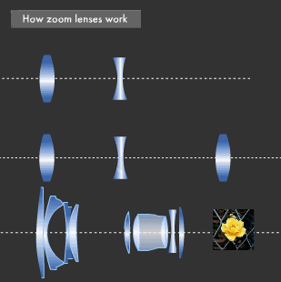
Zooming-- changing f
$$\frac{1}{f}= \frac{1}{u}+ \frac{1}{v}$$
effective focal length
https://global.canon/en/technology/s_labo/light/003/02.html

Slide 42
Same lens (fixed f), increase v
$$\frac{1}{f}= \frac{1}{u}+ \frac{1}{v}$$
extension tube
larger image!
https://expertphotography.com/difference-between-macro-micro-and-close-up-photography/

Slide 43
Also achieved by swapping subject and sensor!
$$\frac{1}{f}= \frac{1}{v}+ \frac{1}{u}$$
reverse ring extension tube
https://121clicks.com/tutorials/use-reverse-ring-extension-tube-macro-photography

Slide 44
Macro photography
high magnification ratio
$$\frac{h_{i}}{h_{o}}$$
35 mm sensor
h_{o}
h_{i}
macro lens
image
object
sensor

Slide 45
Types of lenses
telephoto
f larger than length of lens construction
useful to zoom
compresses range of depths
usually variable focal lengths
and variable f-number (depending on f)
standard/prime
f fixed
no zoom capability
usually high quality build = better image quality
wide angle
f shorter than lens construction
good for landscape
could introduce more distortion

Slide 46
Cameras – sensors
https://www.visiononline.org/userassets/aiauploads/file/cvp_the-fundamentals-of-camera-and-image-sensor-technology_jon-chouinard.pdf
Notes:
8 bits per channel
Store energy in the scene
View, color, energy mapping

Slide 47
Sensor sensitivity and response
Notes:
8 bits per channel
Store energy in the scene
View, color, energy mapping

Slide 48
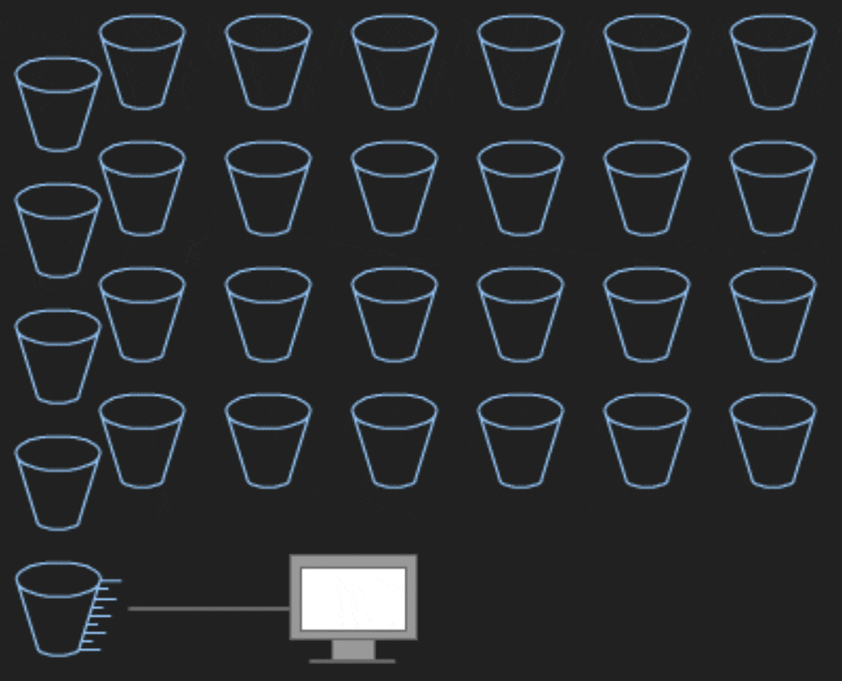
Types of sensors
https://www.photometrics.com/learn/camera-basics/types-of-camera-sensor
https://www.canon-europe.com/pro/infobank/image-sensors-explained/
Notes:
8 bits per channel
Store energy in the scene
View, color, energy mapping

Slide 49
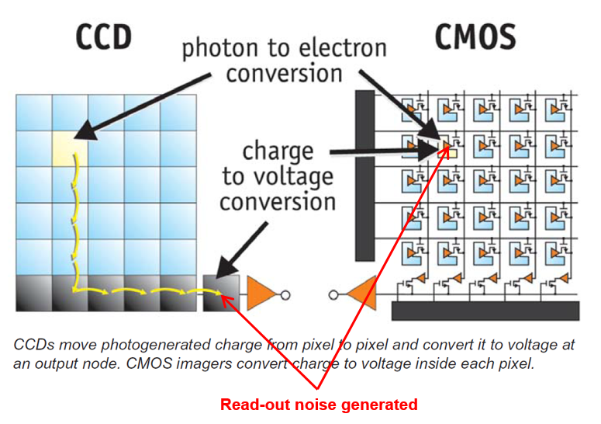
Types of sensors
Read more here, and on this canon website (marketing-speak alert)
Notes:
8 bits per channel
Store energy in the scene
View, color, energy mapping

Slide 50
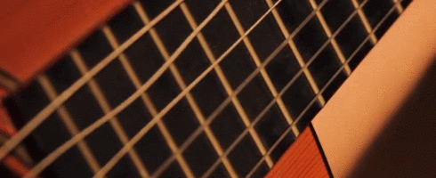
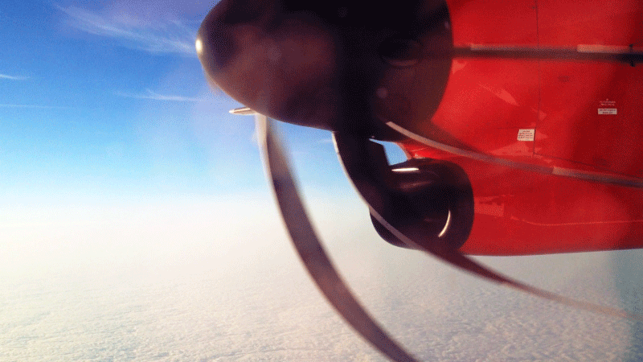

Slide 51
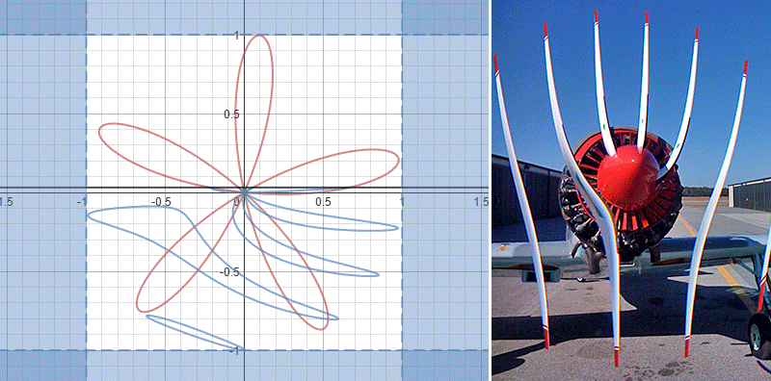
Rolling shutter

Slide 52
The big picture!

Slide 53
CG – account for all factors!

