Slide 1
Computer Graphics: Rendering
Lecture 2: Radiometry, Photometry
Kartic Subr

Slide 2
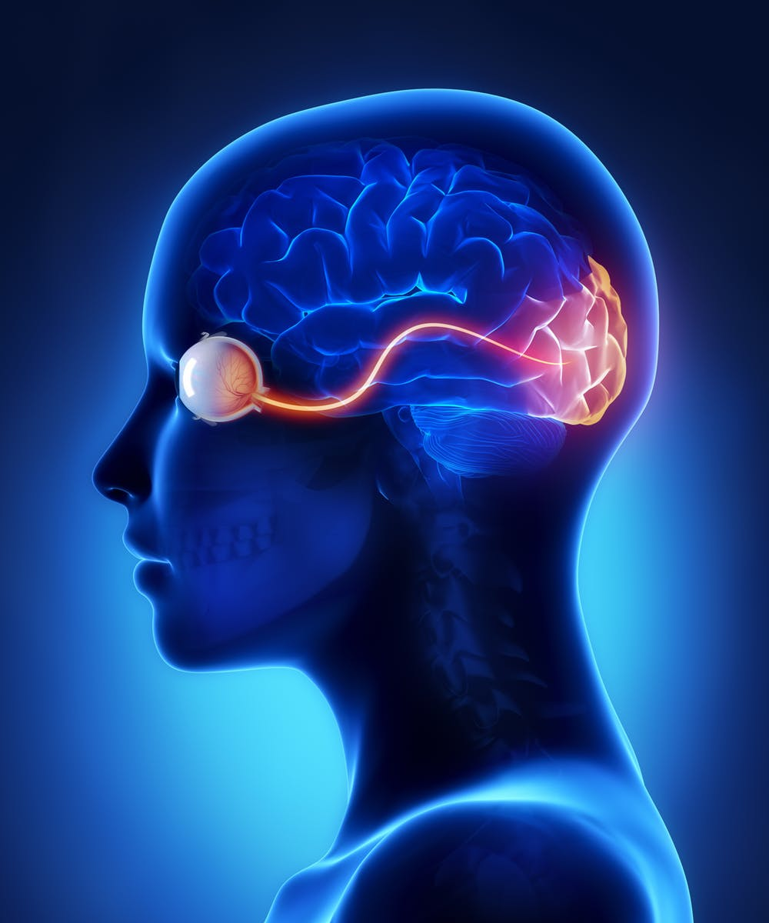
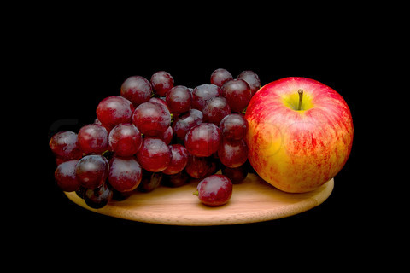
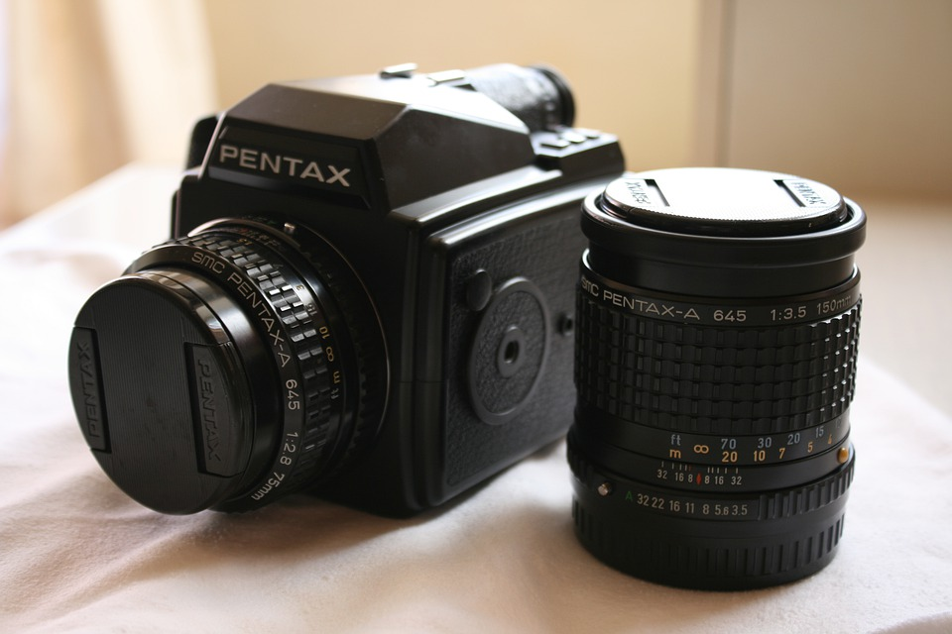
Computer Graphics
Real
photography
image manipulation
rendering
Virtual

Slide 3
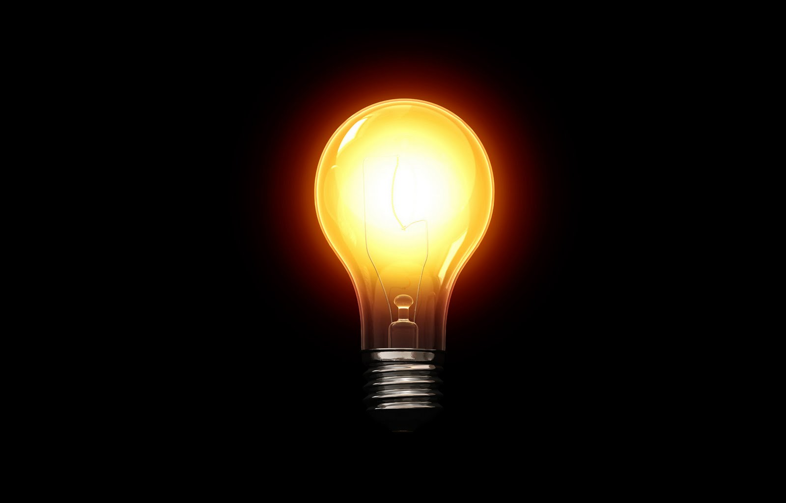
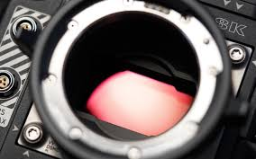
Energy in the scene
Cool visualization in this video

Slide 4
What do cameras record?
Obviously, it is …ehmm
…‘light stuff’?

Slide 5
What is light?

Slide 6
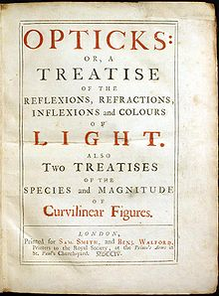
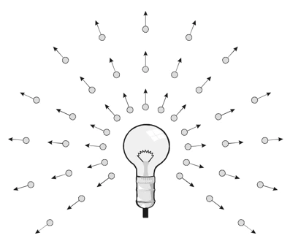
What is light?
Isaac Newton 1704

Slide 7
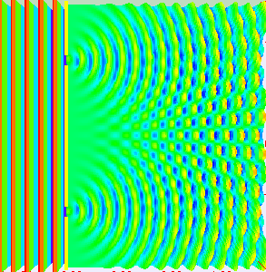
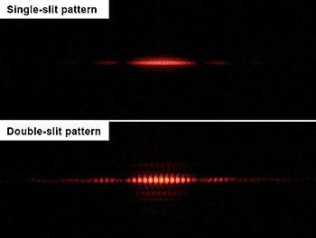
What is light?
Isaac Newton 1704
Thomas Young 1801

Slide 8
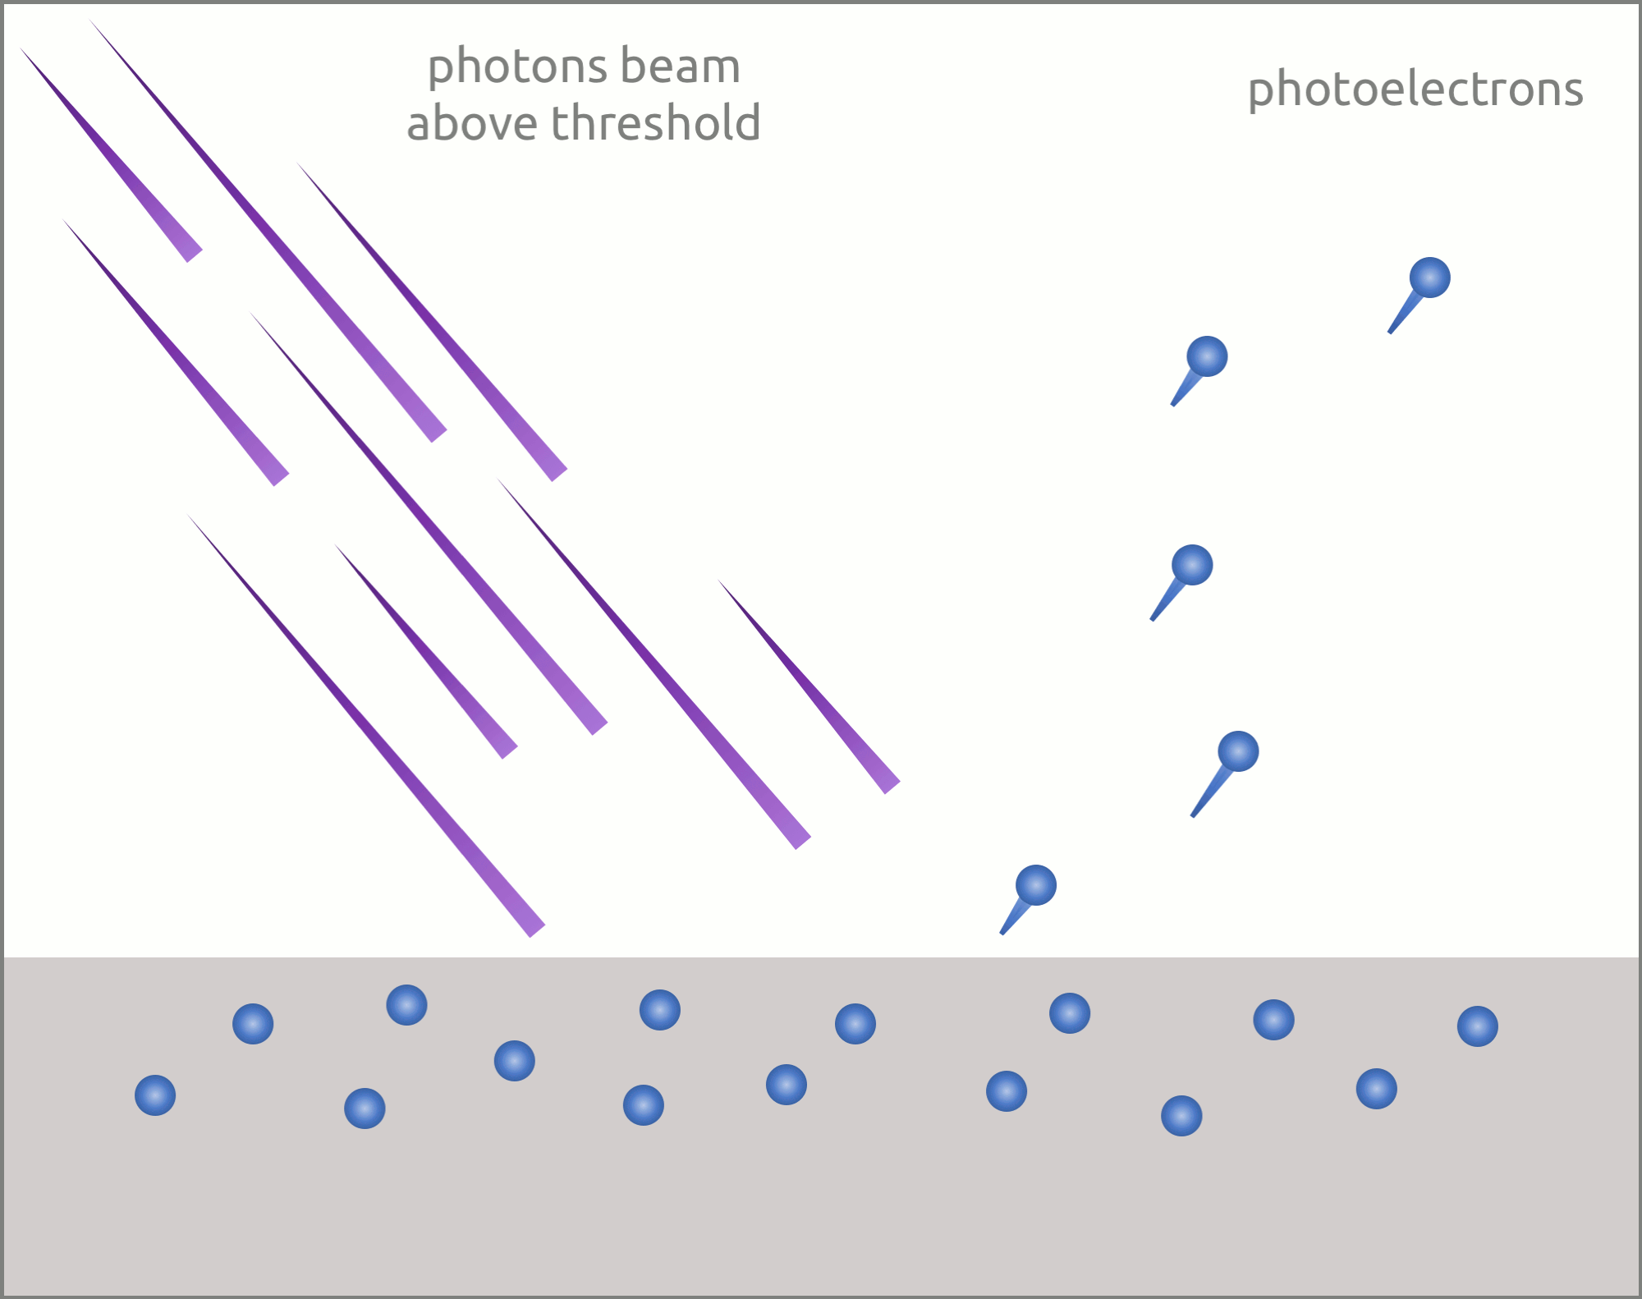
What is light?
Isaac Newton 1704
Thomas Young 1801
1887 Hertz, 1902 Lenard, 1905 Einstein

Slide 9
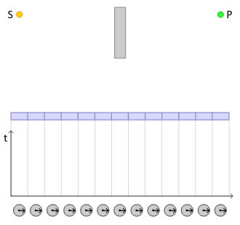
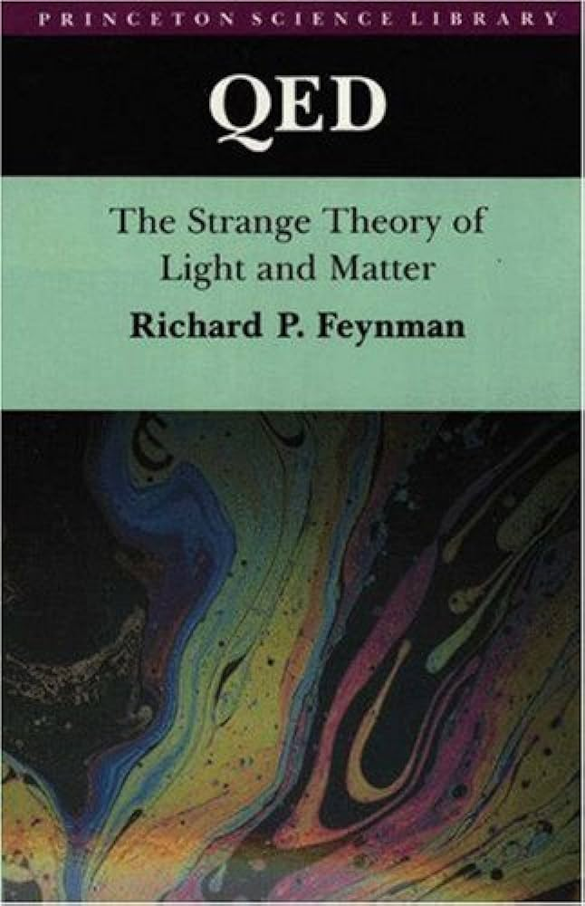
Straight lines?
Feynman 1985, read this

Slide 10
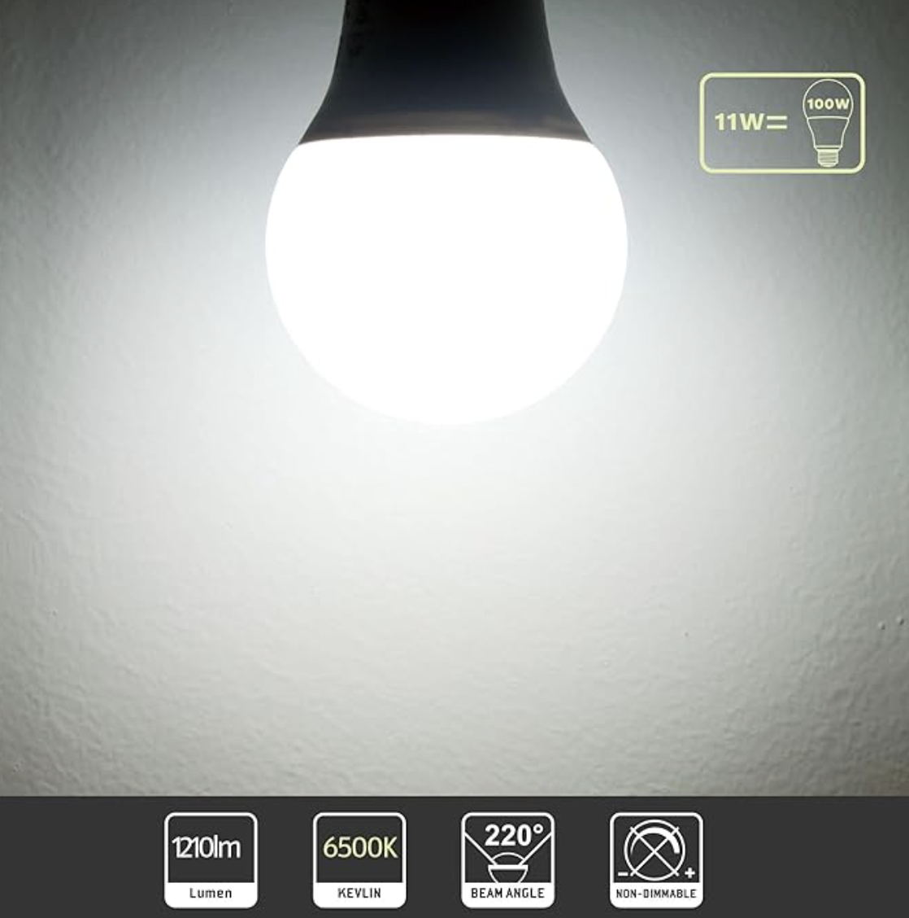
ROTTYI Light Bulbs
100W Equivalent, 6500K Bulbs, 11W 1210LM LED

Slide 11
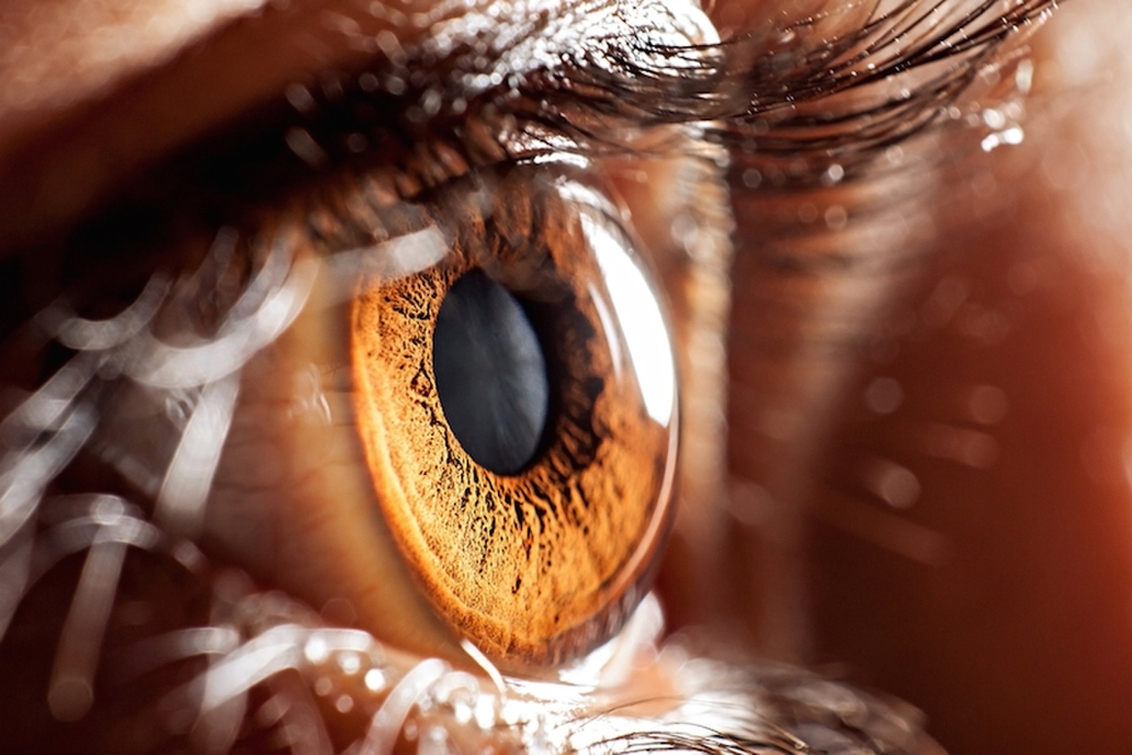
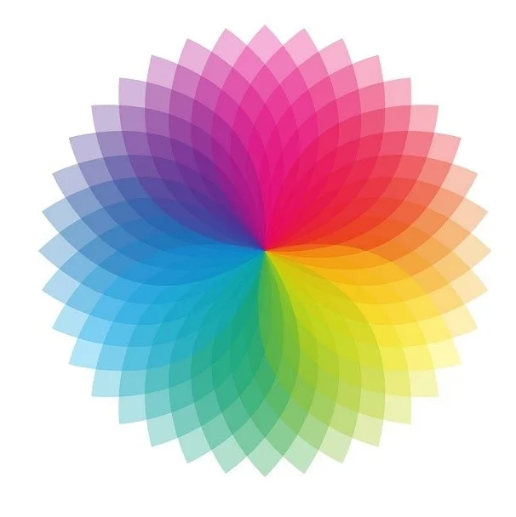
The study of light
radiometry
photometry
colorimetry
Interested in knowing more? Read this

Slide 12
The study of light
photometry

Slide 13
Radiometry

Slide 14
Radiometry
Study of light energy in a scene

Slide 15
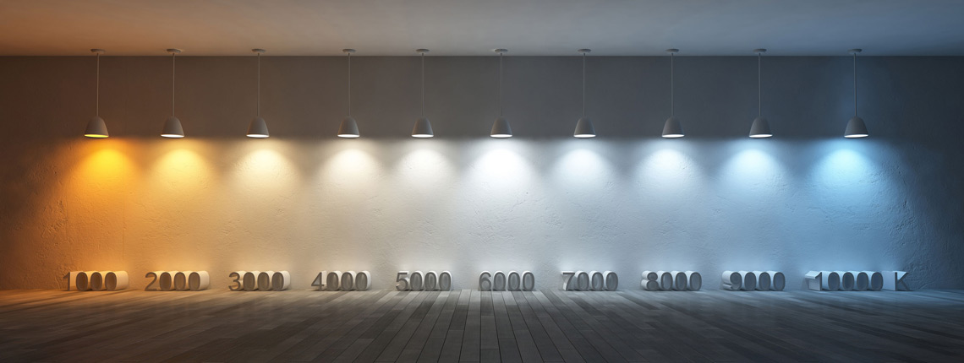
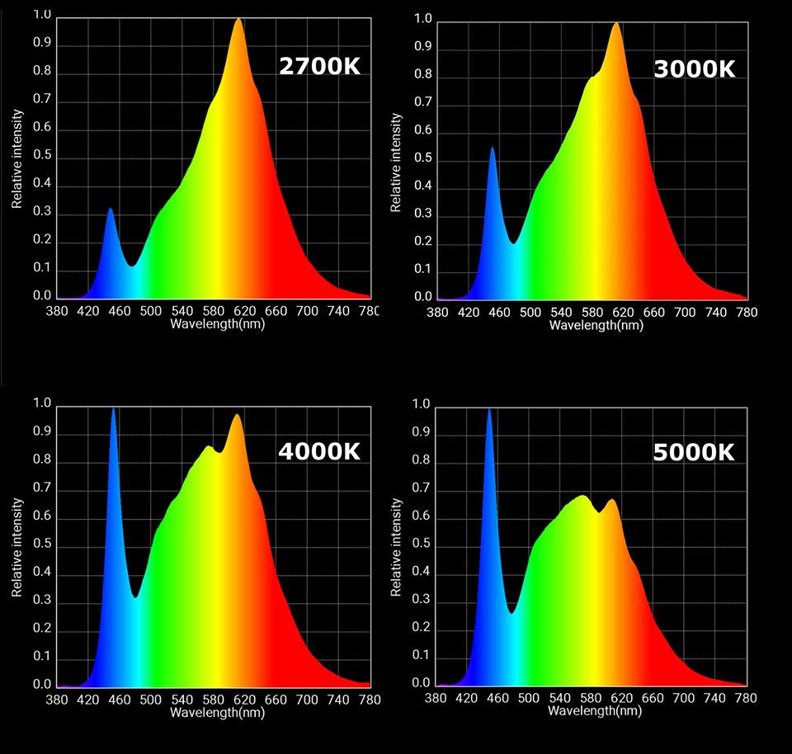
Spectrometry: radiometric qty. per wavelength
https://www.softlights.org/chapter-11-color-temperature/
Interested in modelling this? Look here

Slide 16
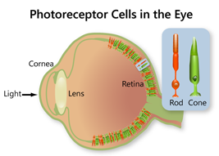
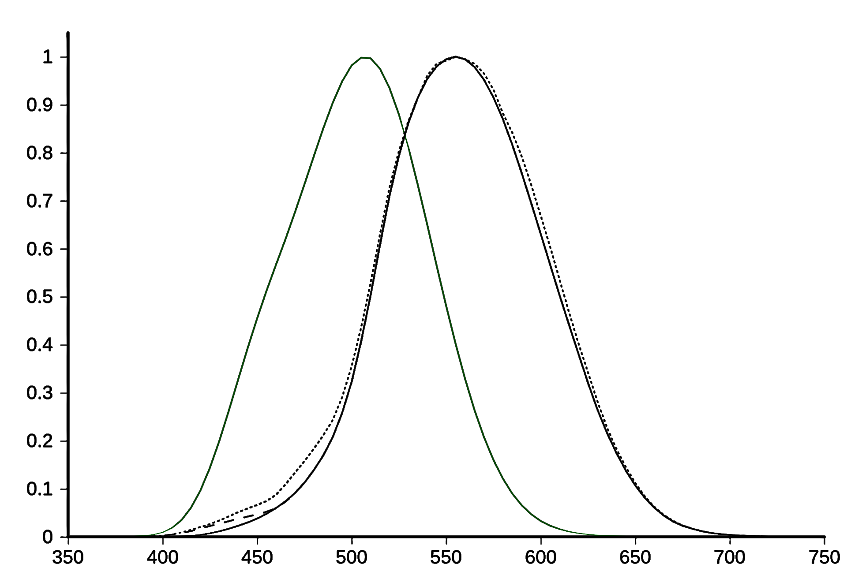
Photometry
Study of perceived light energy in a scene

Slide 18
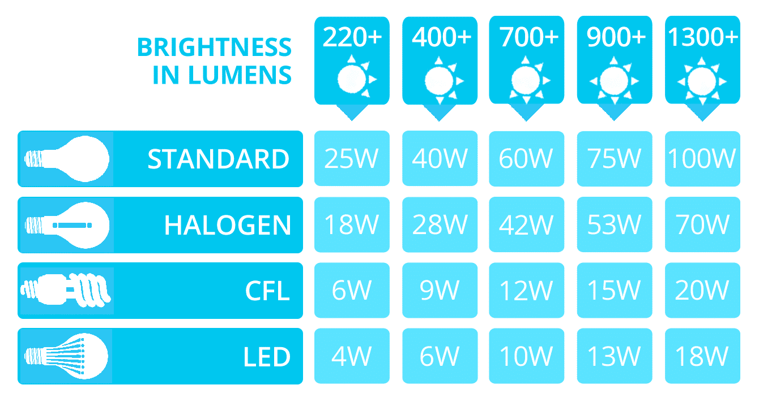

Slide 19
Spectral sensitivity of our eyes

Slide 20
Spectral response of cones

Slide 21
Rods, cones, etc.

Slide 22
plotting S,M,L as 3D points as a function of wavelength

Slide 24
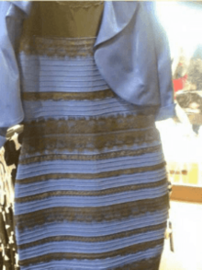
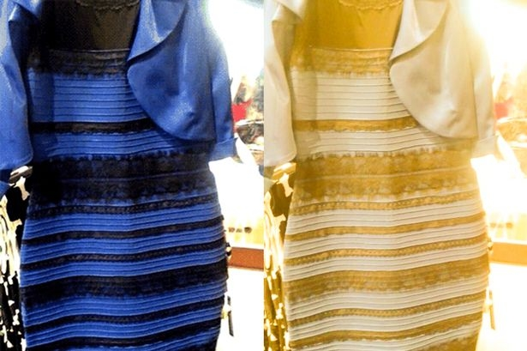
Metamers
http://persci.mit.edu/people/adelson/checkershadow_proof

Slide 25
Trichromatic theory of light

Slide 26
Trichromatic theory of light

Slide 27
Matching Experiment
tweak sliders
r
target colour
observed
colour
g
b

Slide 28
Matching Experiment
g
r
b

Slide 29
Tristimulus values

Slide 30
Tristimulus values

Slide 31
Tristimulus values
Confusing? Read more here
(search for ‘Maxwell’ on the page)
or here

Slide 32
The study of light
radiometry
photometry
colorimetry
Interested in knowing more? Read this

