Slide 1
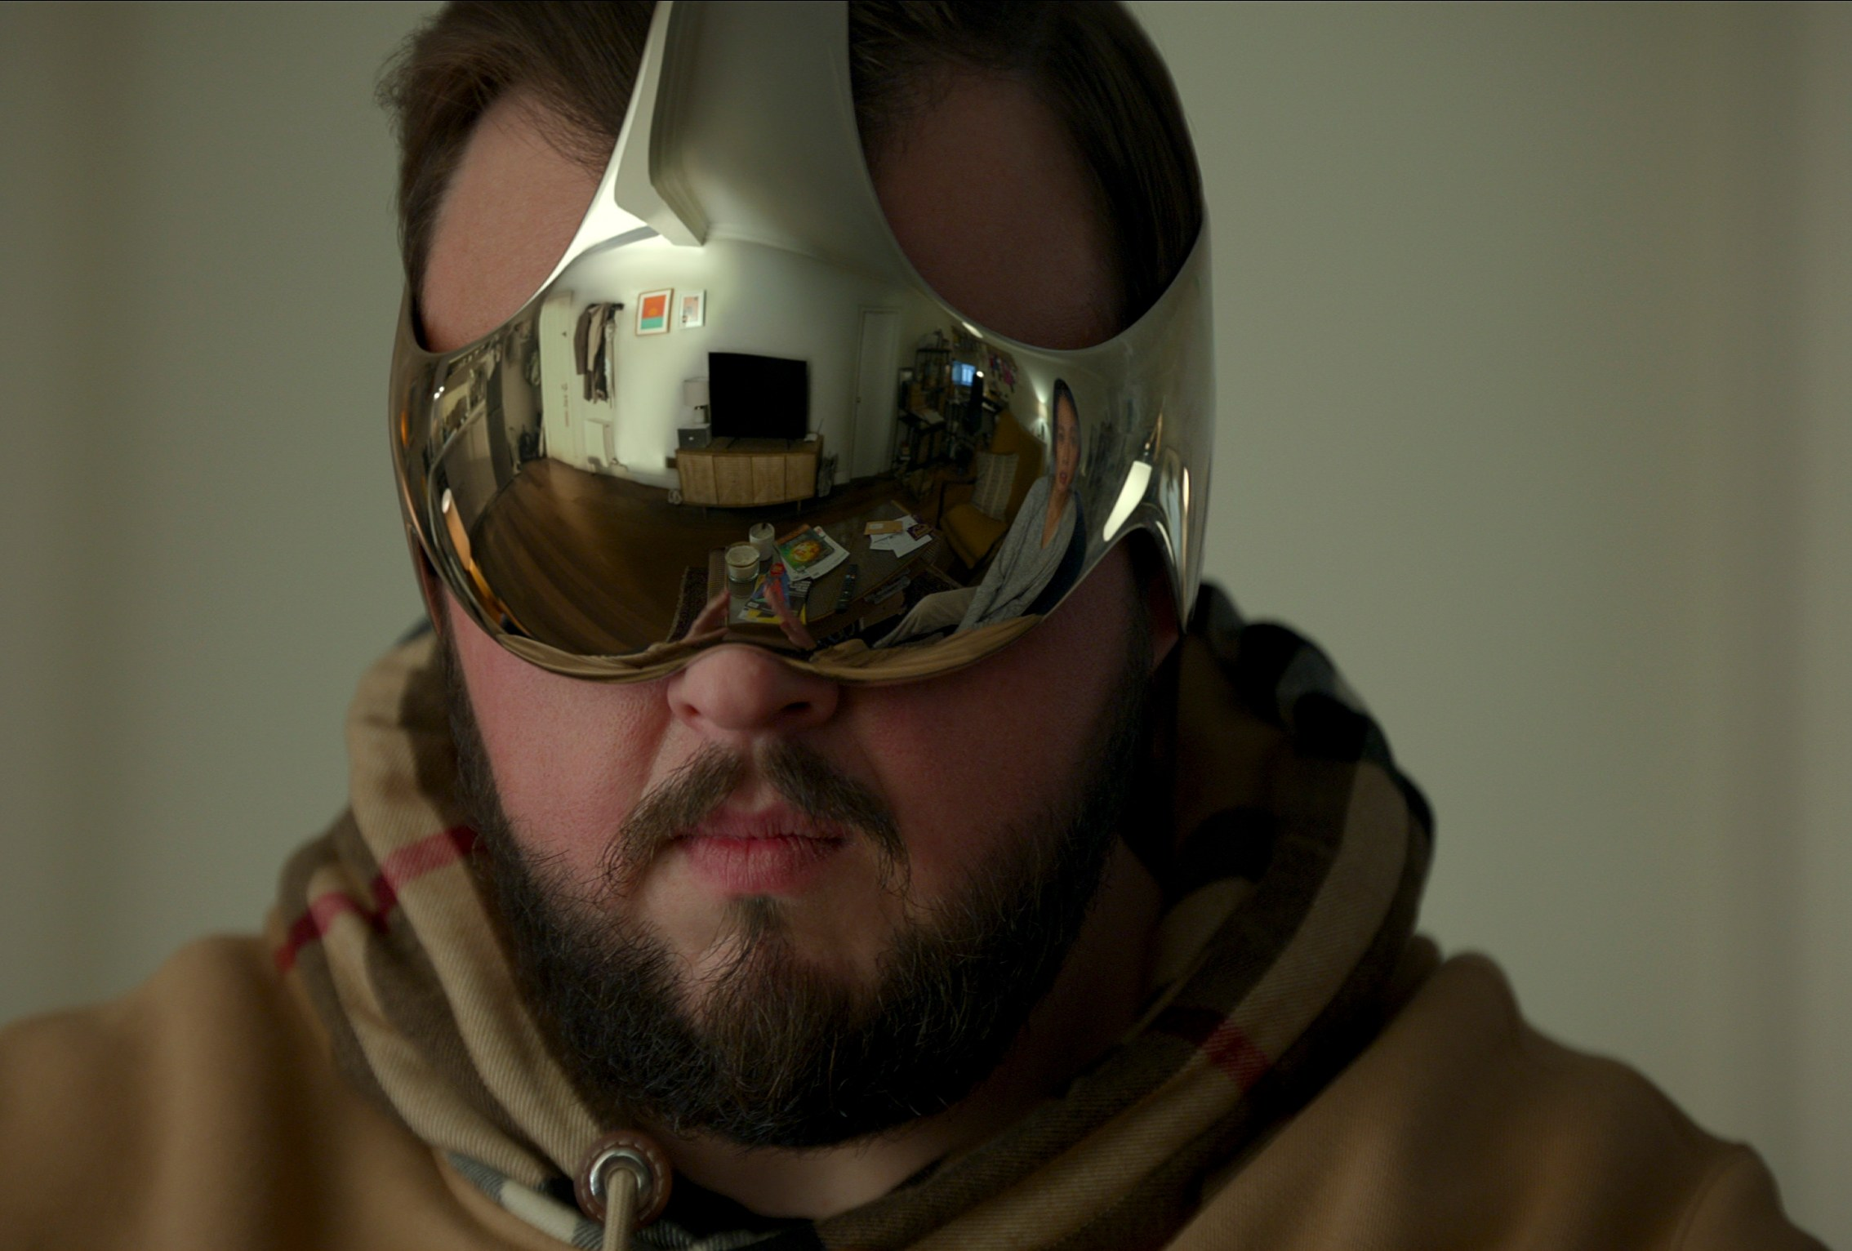
Computer Graphics
Lecture 17: VR and conclusion
Kartic Subr

Slide 2
On demand: Shadow maps

Slide 3
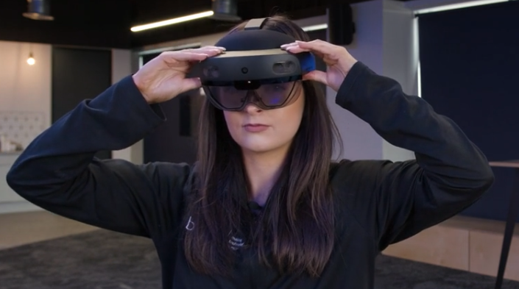
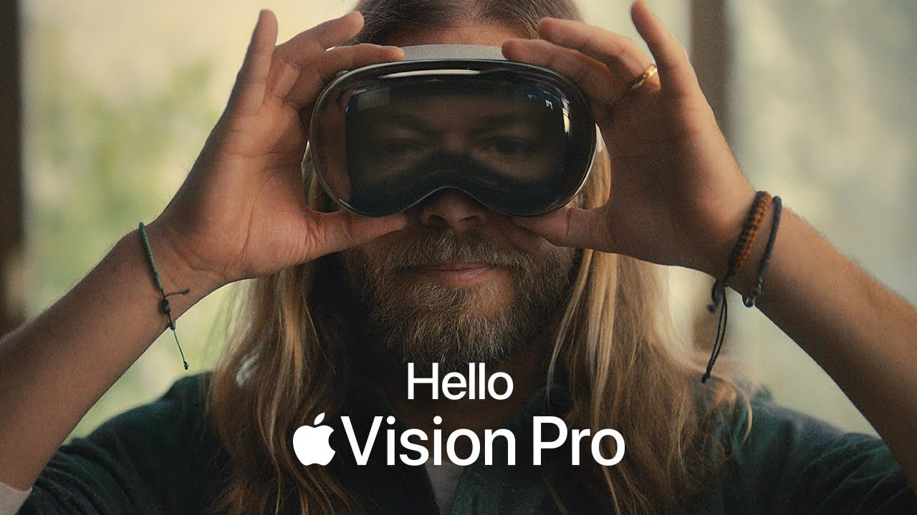
https://virtualspeech.com/blog/history-of-vr

Slide 4
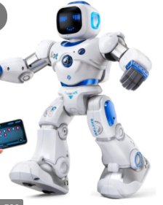
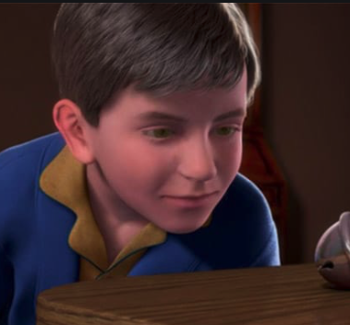

Slide 5
The uncanny valley [Masahiro Mori 1970]

Slide 6
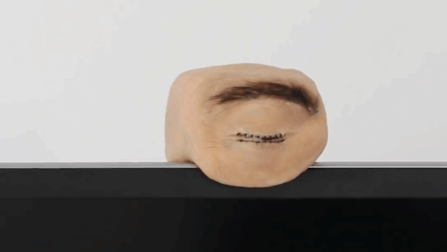
The uncanny valley [Masahiro Mori 1970]

Slide 8
VR systems
Human stereo vision
Display technology
Low-latency stereo rendering algorithm
Haptic feedback
VR smell
Stereo/surround sound

Slide 9
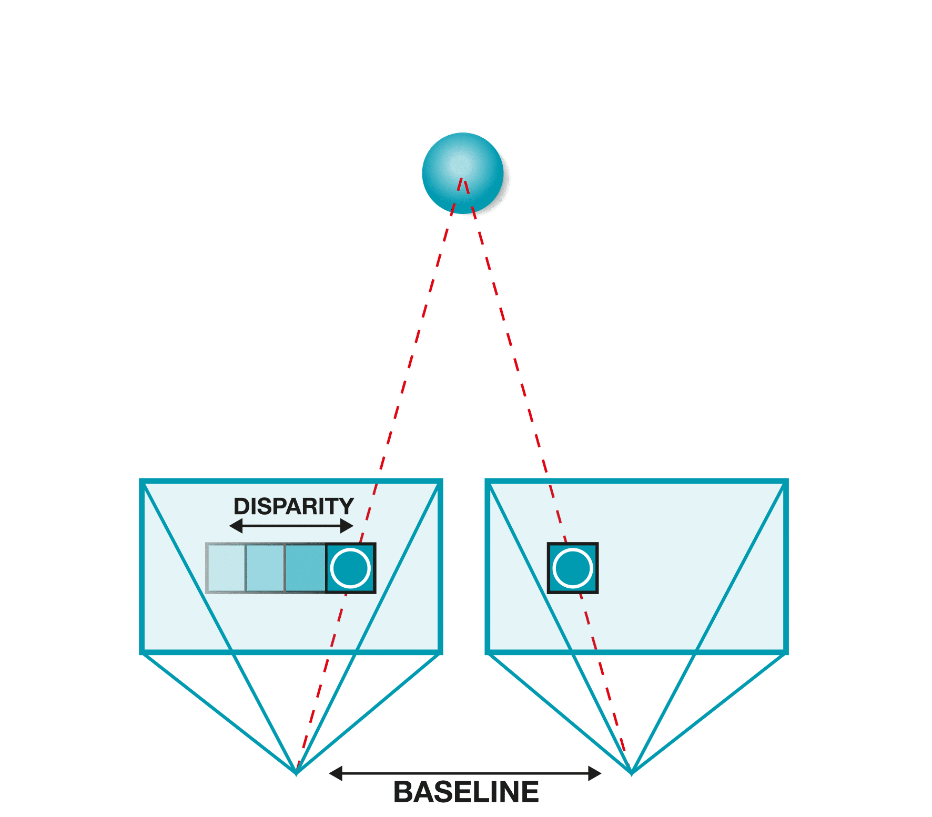
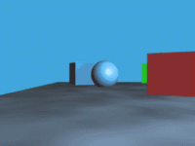
Stereopsis
parallax

Slide 10
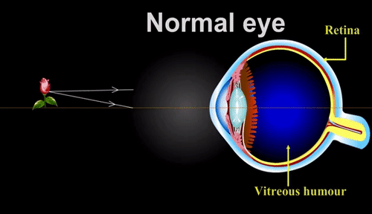
Focus

Slide 11
Conflict – flat stereo displays

Slide 12
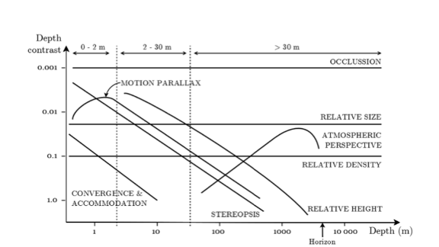
Depth perception
cutting and vishton 1995

Slide 13
Visual Field
https://www.lecturio.com/concepts/the-visual-pathway-and-related-disorders/

Slide 14
Visual System - considerations

Slide 15
VR systems
Human stereo vision
Display technology
Low-latency stereo rendering algorithm
Haptic feedback
VR smell
Stereo/surround sound

Slide 16
3D displays?

Slide 17
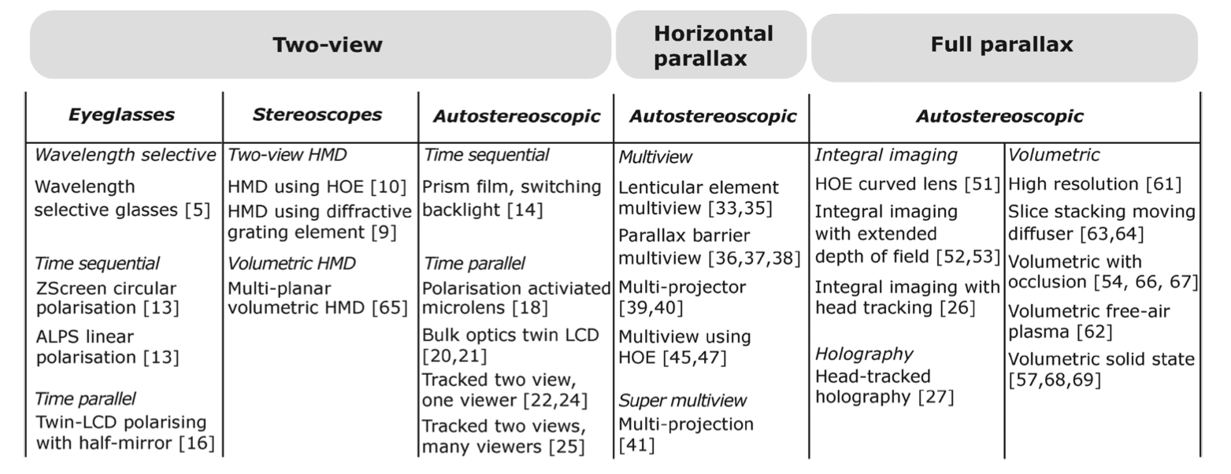
3D displays
Holliman et al 2011

Slide 18
Stereo displays

Slide 19
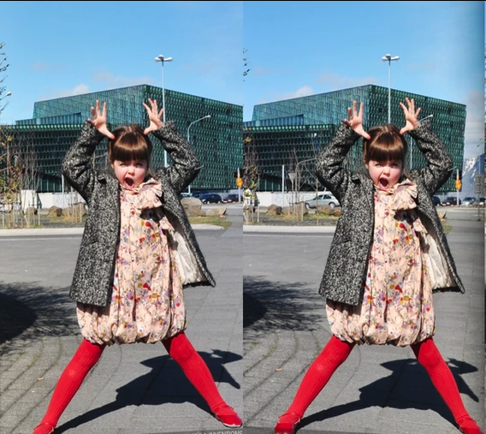
Stereo displays
Side-by-side images
wall-eyed
cross-eyed
Stereoscopes
Anaglyphs
Polarisation
Eclipse (active shutters)
Interference
Autostereoscopy
https://www.kula3d.com/how-to-use-the-cross-eyed-method

Slide 20
Stereo displays
Side-by-side images
wall-eyed
cross-eyed
Stereoscopes
Anaglyphs
Polarisation
Eclipse (active shutters)
Interference
Autostereoscopy
19th century

Slide 21
Stereo displays
Side-by-side images
wall-eyed
cross-eyed
Stereoscopes
Anaglyphs
Polarisation
Eclipse (active shutters)
Interference
Autostereoscopy

Slide 22
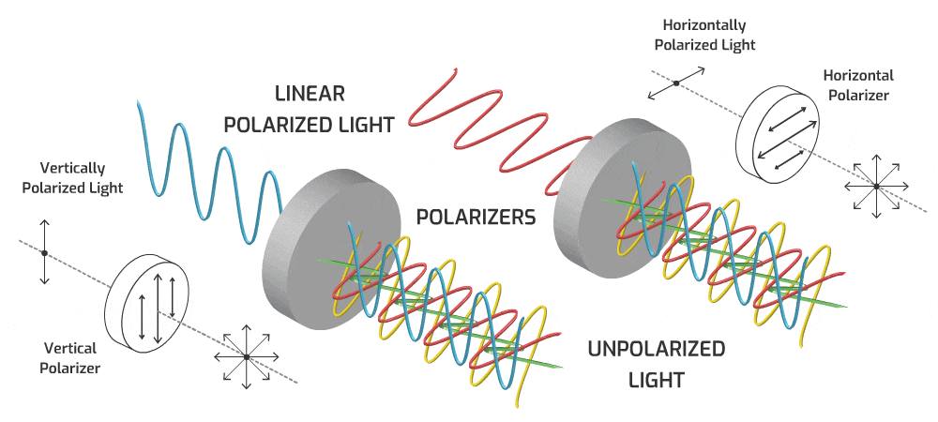
Stereo displays
Side-by-side images
wall-eyed
cross-eyed
Stereoscopes
Anaglyphs
Polarisation
Eclipse (active shutters)
Interference
Autostereoscopy
circularly polarised

Slide 23
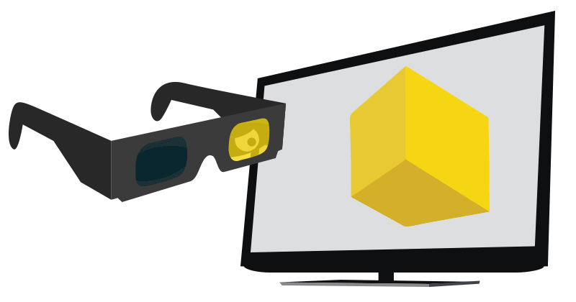
Stereo displays
Side-by-side images
wall-eyed
cross-eyed
Stereoscopes
Anaglyphs
Polarisation
Eclipse (active shutters)
Interference
Autostereoscopy

Slide 24
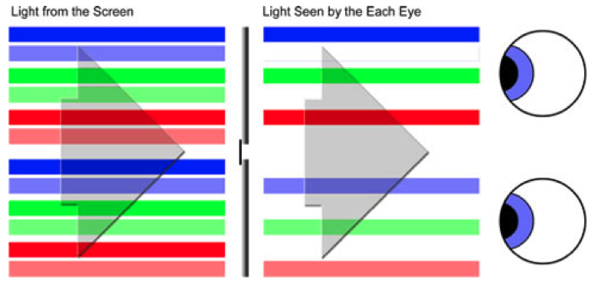
Stereo displays
Side-by-side images
wall-eyed
cross-eyed
Stereoscopes
Anaglyphs
Polarisation
Eclipse (active shutters)
Chromatic/Interference
Autostereoscopy

Slide 25
Stereo displays
Side-by-side images
wall-eyed
cross-eyed
Stereoscopes
Anaglyphs
Polarisation
Eclipse (active shutters)
Chromatic/Interference
Autostereoscopy

Slide 26
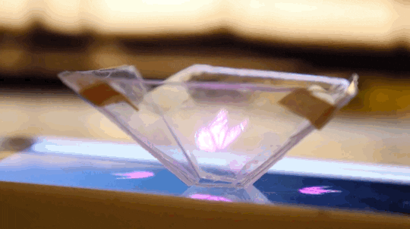
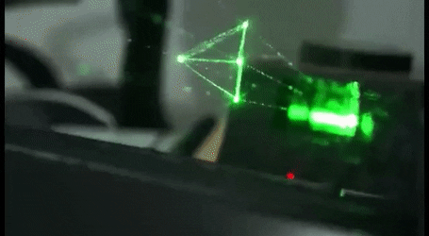
Holographic displays

Slide 27
Head mounted displays

Slide 28
VR systems
Human stereo vision
Display technology
Low-latency stereo rendering algorithm
Haptic feedback
VR smell
Stereo/surround sound

Slide 29
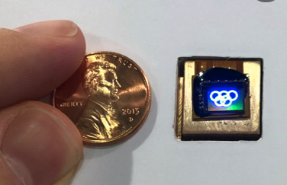
Stereo rendering for HMDs
micro-display

Slide 30
Most HMDs are simple magnifiers
micro-display

Slide 31
Single view – centred scene
y
z

Slide 32
Single view – symmetric view frustum
y
side view
z

Slide 33
Two views ?
shift only
shift and rotate
http://paulbourke.net/stereographics/stereorender/

Slide 34
Two views ?
creates vertical parallax
off-axis
toe-in
http://paulbourke.net/stereographics/stereorender/

Slide 35
Two views ?
creates vertical parallax
off-axis
toe-in
http://paulbourke.net/stereographics/stereorender/

Slide 36
Two views – asymmetric frusta
x
side view
z

Slide 37
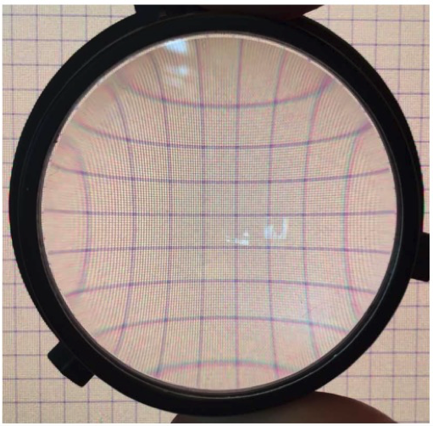
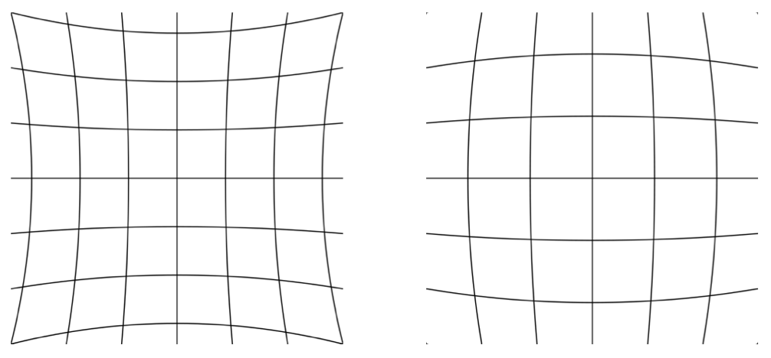
Lens distortion
pin-cushion distortion
barrel distortion

Slide 38
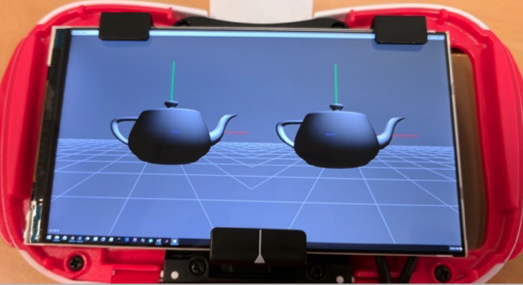
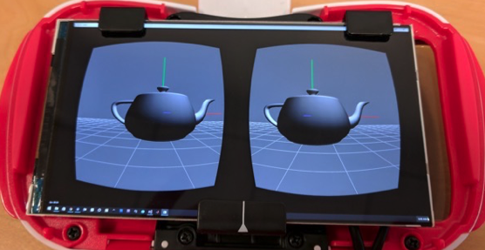
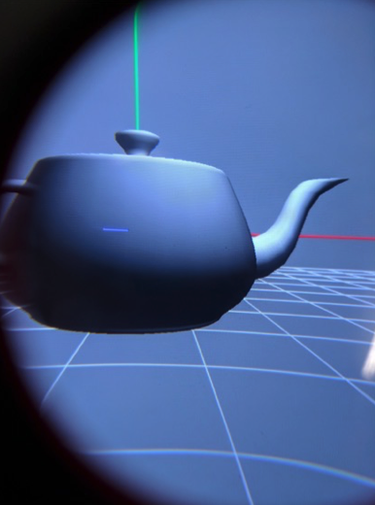
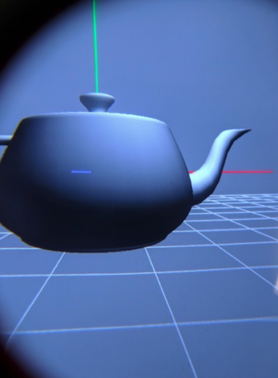
Lens distortion correction

Slide 39
https://virtualspeech.com/blog/history-of-vr

Slide 40
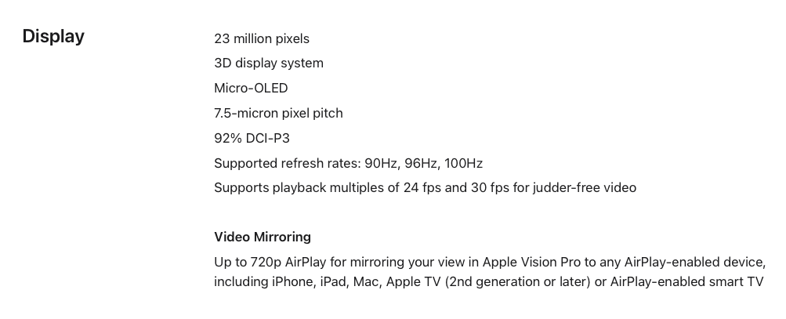
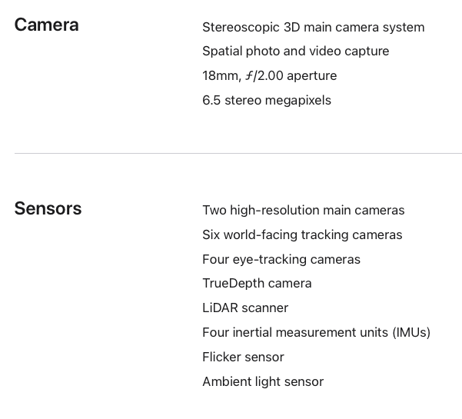
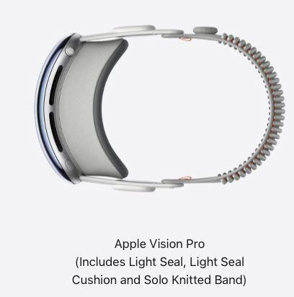

Slide 41
Interested readers …
https://stanford.edu/class/ee267/syllabus.html

Slide 42
This course …
Theory (19h)
17h lectures
2h reading
Practice (66h)
2h tutorials
32h CW1
about 32h CW2

Slide 43
Main feedback/criticism
CW1 took too long
Course notes might be helpful
Would like more maths!
Presentations for CW1 caused confusion, given enrolment
Subjective assessment

Slide 44
I would like your feedback on …
Suggestions for changes to syllabus?

Slide 45
Feedback/nomination
1) course survey
2) Nominate for award
https://forms.office.com/e/r6XvcpSUze
teaching.awards@eusa.ed.ac.uk
https://www.eusa.ed.ac.uk/whatson/awards/teachingawards/faqs
(cookies trouble? try it in an incognito window)

