Slide 1
Computer Graphics Rendering
Lecture 16: ML in Computer Graphics
Kartic Subr

Slide 2
Interpolation (regression)

Slide 3
Interpolation (regression)

Slide 4
Interpolation (regression)

Slide 5
Interpolation (regression)
overfitting

Slide 6
Interpolation (regression)
https://xkcd.com/2048/

Slide 7
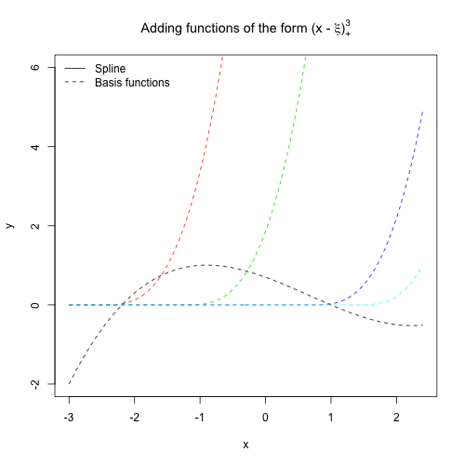
Fitting using a basis
https://stats.stackexchange.com/questions/433458/spline-basis-function-notation-to-include-constraint-for-continuity-at-the-knots
https://www.cs.princeton.edu/courses/archive/fall18/cos324/files/basis-functions.pdf

Slide 8
Fitting using a basis
$$w_{1}$$
$$(x)$$
$$+$$
$$w_{2}$$
$$(x)$$
$$y\left(x \right)=$$
$$+$$
$$w_{3}$$
$$(x)$$
$$+$$
$$w_{4}$$
$$(x)$$

Slide 9
Fitting = determining weights
$$w_{1}$$
$$(x)$$
$$+$$
$$w_{2}$$
$$(x)$$
$$y\left(x \right)=$$
$$+$$
$$w_{3}$$
$$(x)$$
$$+$$
$$w_{4}$$
$$(x)$$

Slide 10
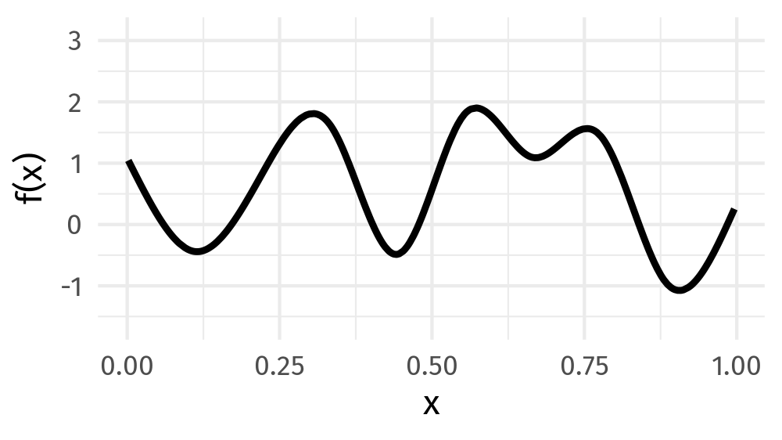
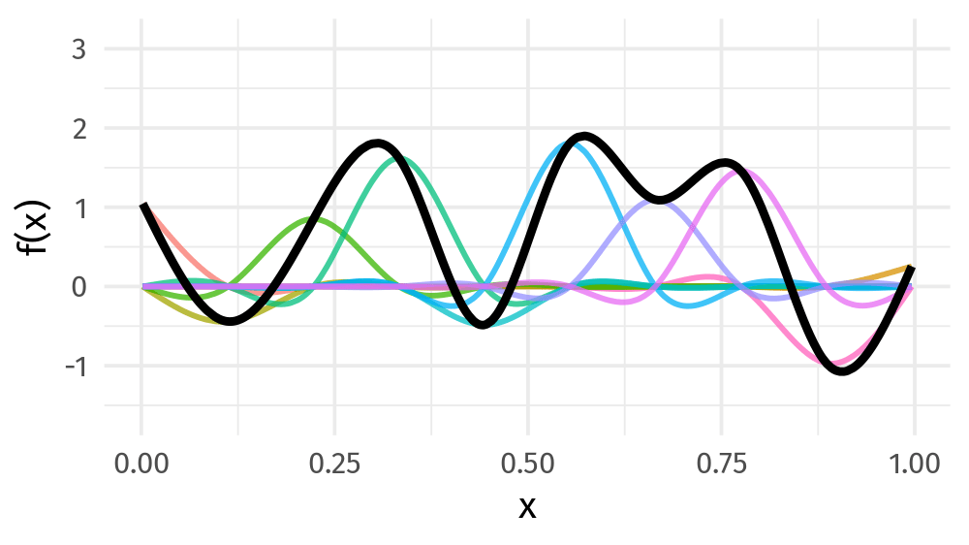
Projection onto fixed bases
input
fixed basis functions
input – projected onto basis

Slide 11
Same function, different transformations
rotation, scaling, shear
translate
$$w_{1}$$
$$(M_{1}x+v_{1})$$
$$+$$
$$w_{2}$$
$$(M_{2}x+v_{2})$$
$$y\left(x \right)=$$
$$+$$
$$w_{3}$$
$$(M_{3}x+v_{3})$$
$$+$$
$$w_{4}$$
$$(M_{4}x+v_{4})$$

Slide 12
$$w$$
$$b$$
$$σ\left(x\right)≡\frac{1}{1−e^{−(wx+b)}}$$

Slide 13
$$w$$
$$b$$
$$σ\left(x\right)≡\frac{1}{1−e^{−(wx+b)}}$$

Slide 14
$$w$$
$$b$$
$$σ\left(x\right)≡\frac{1}{1−e^{−(wx+b)}}$$

Slide 15
$$w$$
$$b$$
$$σ\left(x\right)≡\frac{1}{1−e^{−(wx+b)}}$$

Slide 16
$$w$$
$$b$$
$$x$$
$$)$$
$$σ$$
$( w +b$

Slide 17
$$+$$
$$σ$$
$$($$
$$x$$
$$+$$
$$)$$
$$+$$
$$+$$

Slide 18
$$+$$
$$σ$$
$$($$
$$x$$
$$+$$
$$)$$
$$+$$
$$+$$

Slide 19
$$+$$
$$σ$$
$$($$
$$x$$
$$+$$
$$)$$
$$+$$
$$+$$

Slide 20
$$+$$
$$σ$$
$$($$
$$x$$
$$+$$
$$)$$
$$+$$
$$+$$

Slide 21
$$+$$
$$.$$
$$σ$$
$$($$
$$x$$
$$+$$
$$)$$
$$+$$
$$+$$

Slide 22
$$+$$
$$.$$
$$σ$$
$$($$
$$x$$
$$+$$
$$)$$
$$+$$
$$+$$
$$+$$

Slide 23
$$w_{2}$$
$$w_{1}$$
$$b_{1}$$
$$b_{2}$$
$$+$$
$$.$$
$$σ$$
$$($$
$$x$$
$$+$$
$$)$$
$$+$$
$$+$$
$$+$$

Slide 24
$$Single layer of a fully−connected neural network$$
$$w_{2}$$
$$w_{1}$$
$$b_{1}$$
$$b_{2}$$
$$+$$
$$.$$
$$σ$$
$$($$
$$x$$
$$+$$
$$)$$
$$+$$
$$+$$
$$+$$

Slide 25
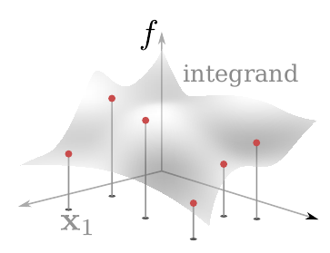

Slide 26
$$.$$
$$σ$$
$$($$
$$x$$
$$+$$
$$)$$
$$+$$

Slide 27
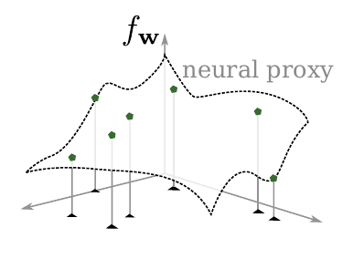

Slide 32
Building blocks to architectures …

Slide 33
Neural networks
Fully connected Networks
Convolutional Neural Networks (CNN)
GANs
Transformers
Foundation models
Diffusion Models

Slide 34
https://devopedia.org/supervised-vs-unsupervised-learning

Slide 35
First, some older usage …
Regression (radiance function)
Dimensionality reduction (manifold of fonts)
- Generative modelling (VQGAN)

Slide 36
Neural Radiance Fields

Slide 37
Neural Radiance Fields

Slide 38
Neural Radiance Fields

Slide 39
Neural Radiance Fields

Slide 40
https://repo-sam.inria.fr/fungraph/3d-gaussian-splatting/

Slide 41
Dimensionality reduction
http://vecg.cs.ucl.ac.uk/Projects/projects_fonts/projects_fonts.html

Slide 42
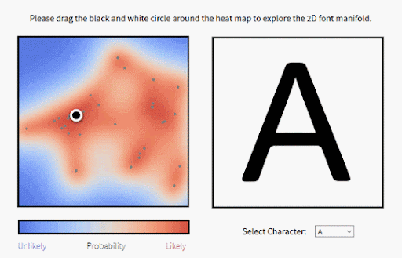
Manifold of fonts (GPLVM)
http://vecg.cs.ucl.ac.uk/Projects/projects_fonts/projects_fonts.html

Slide 43
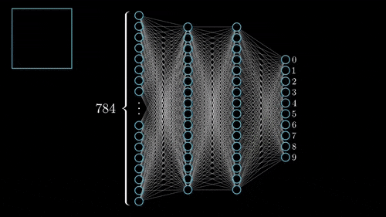
Encoder

Slide 44
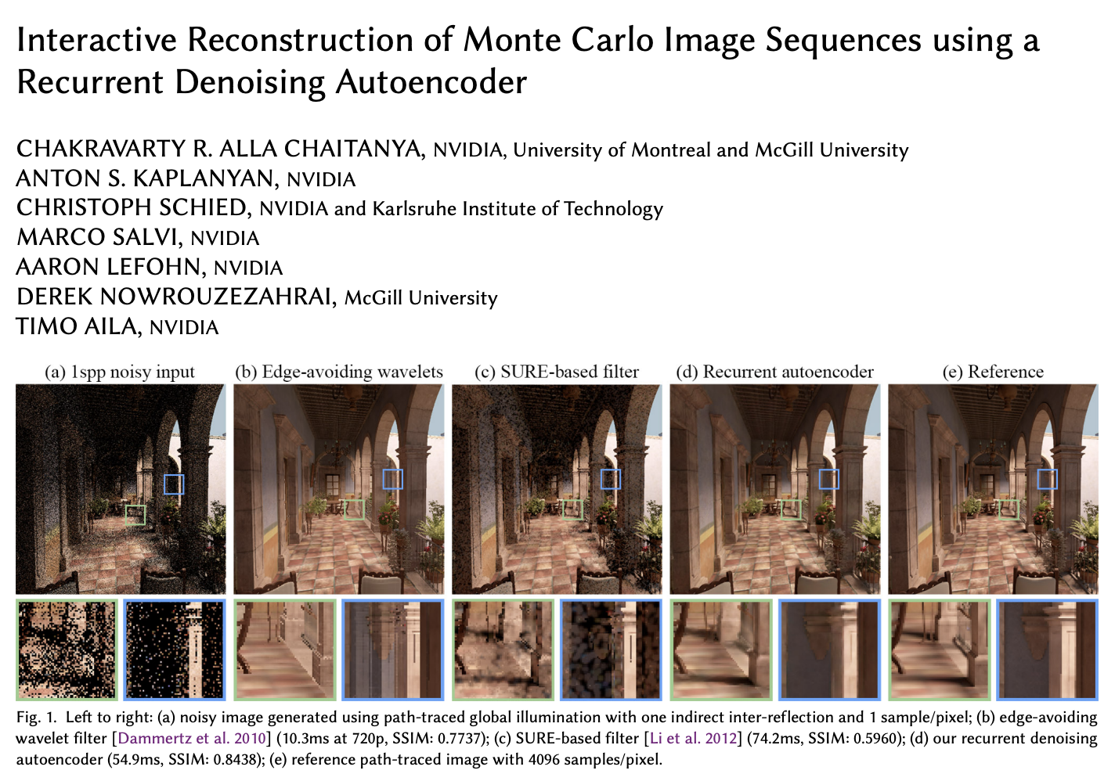
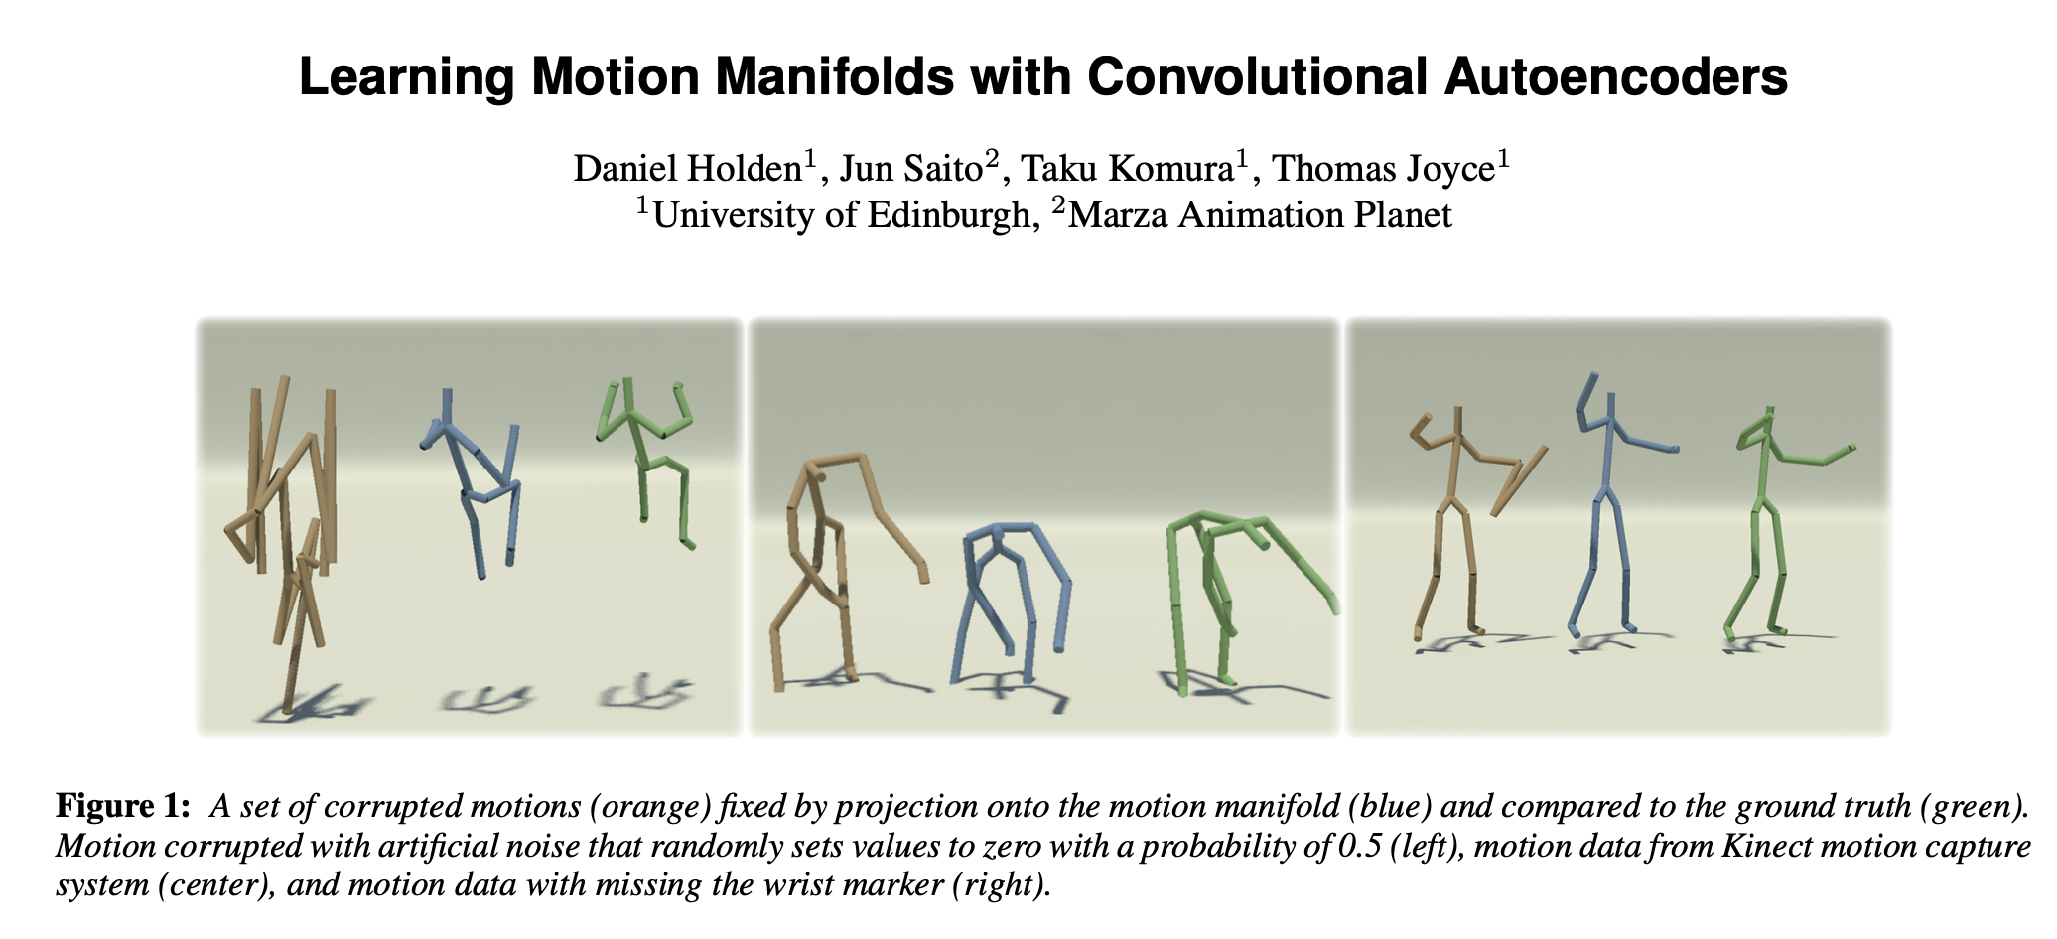

Slide 45
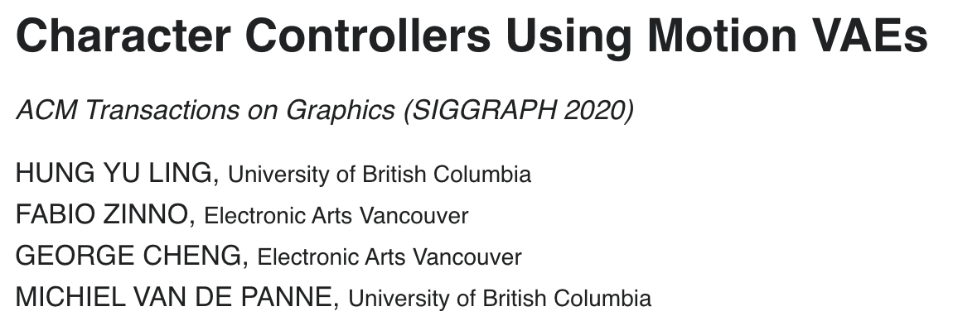
https://hungyuling.com/projects/MVAE/

Slide 46
VQGAN
CVPR 2021
https://github.com/CompVis/taming-transformers

Slide 47
VQGAN: Text to image
Input: “A bird drawn by a child”

Slide 48
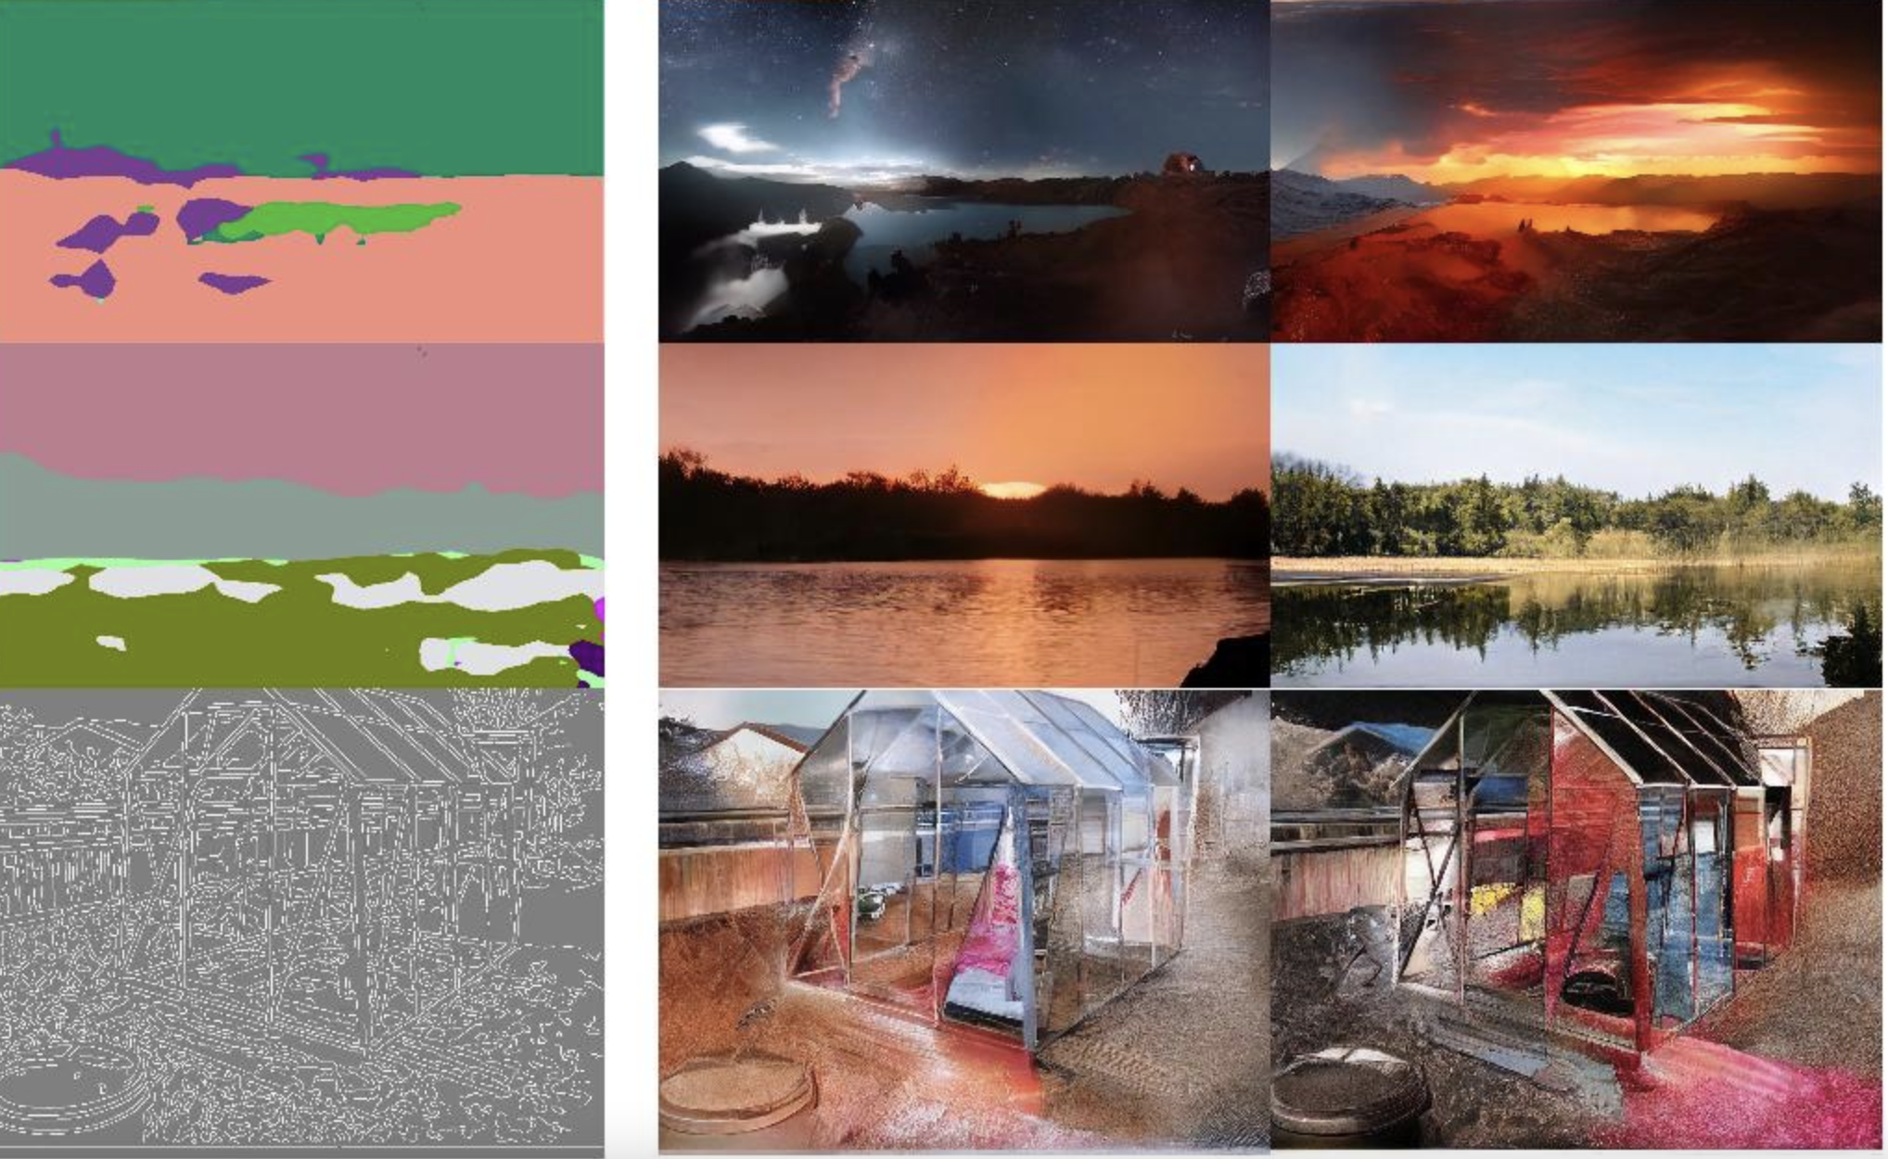
VQGAN: Conditional image synthesis

Slide 49
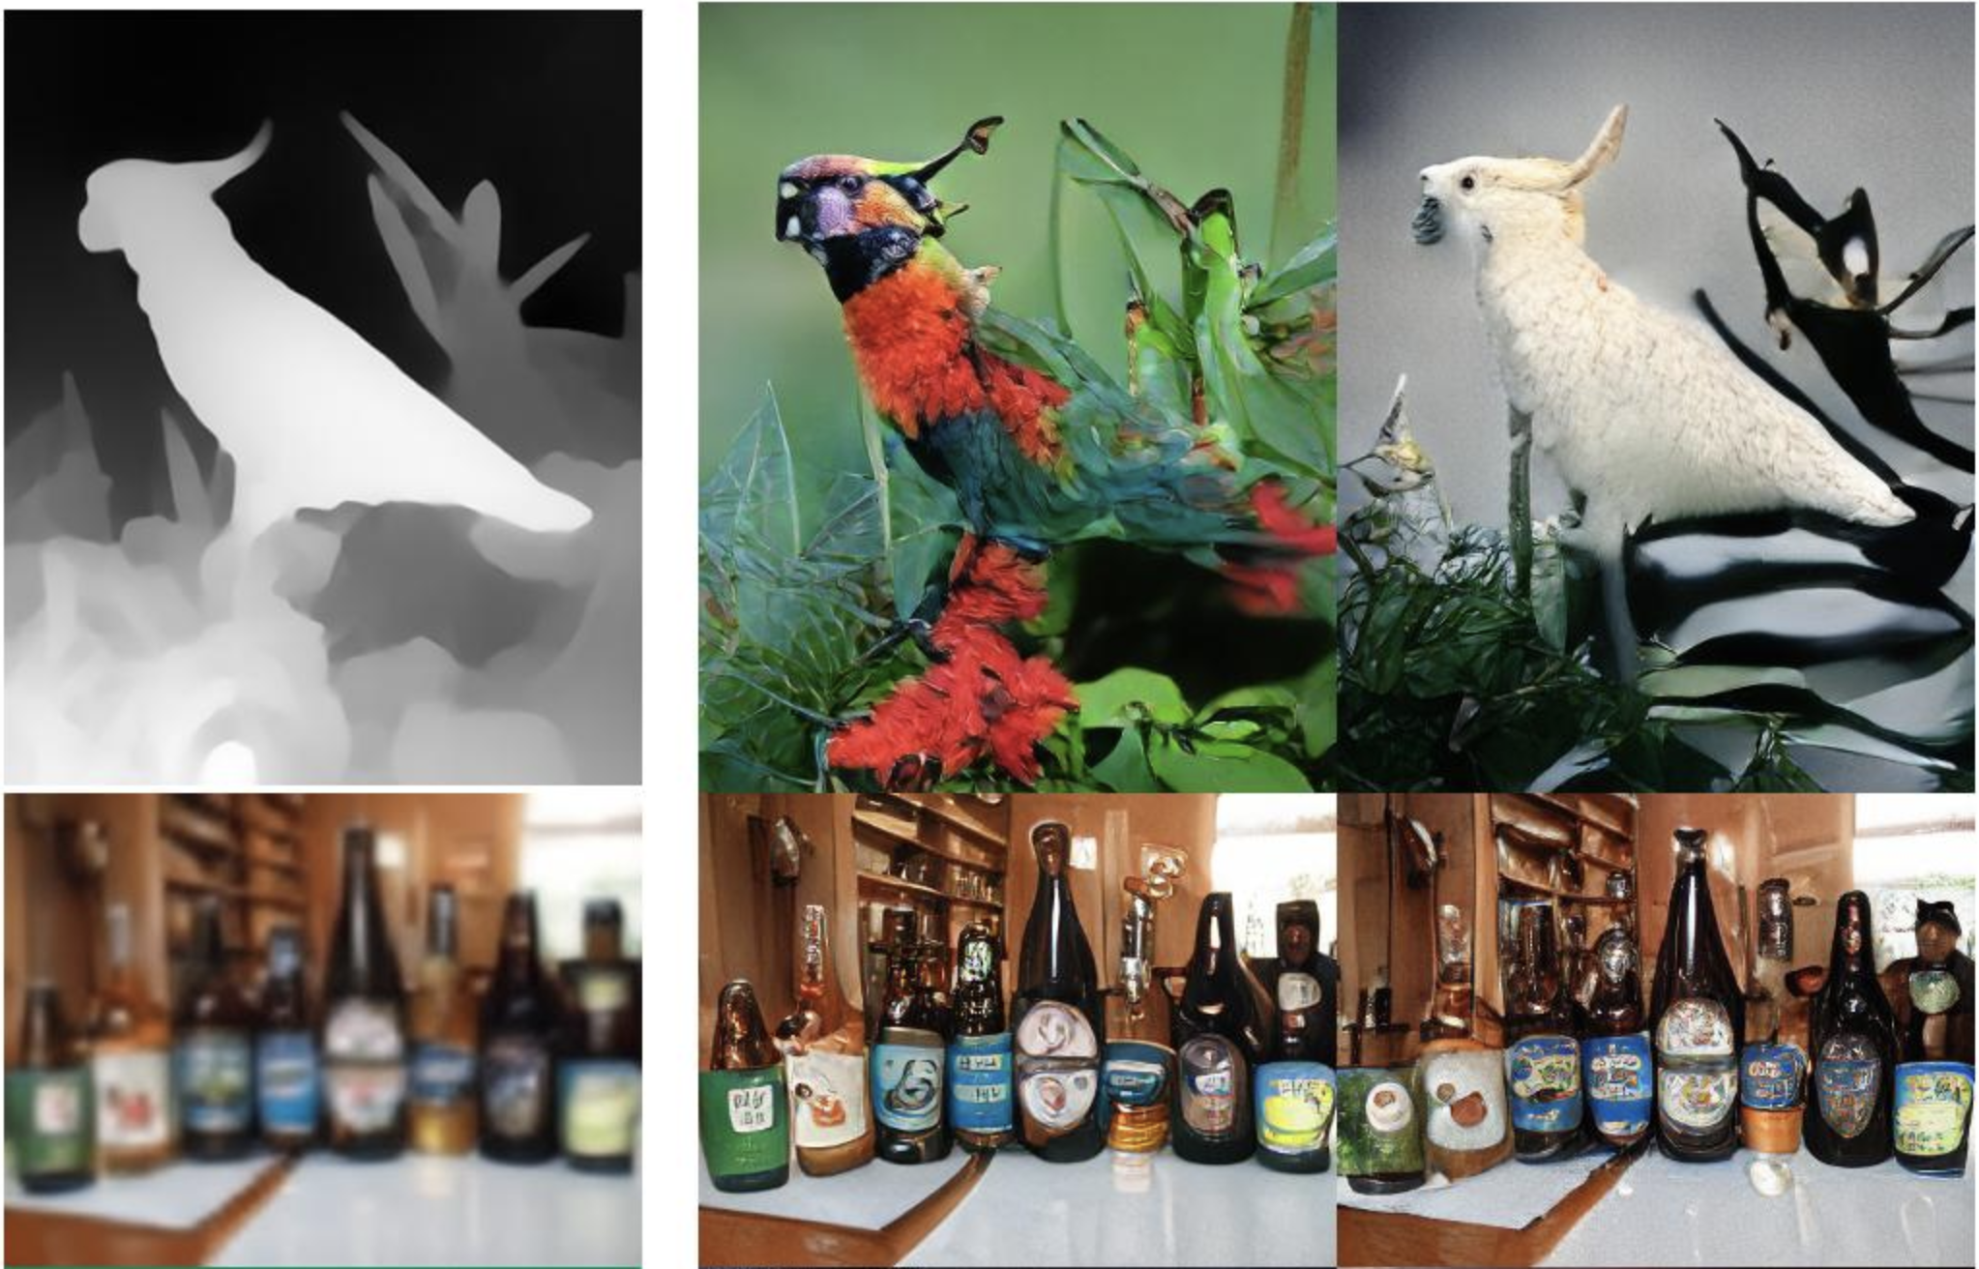
VQGAN: Conditional image synthesis

Slide 50
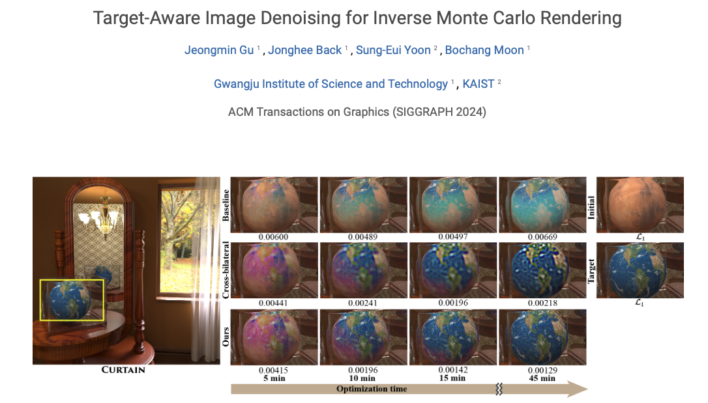
Gen. Models for CG in SIGGRAPH 2024 …

Slide 51
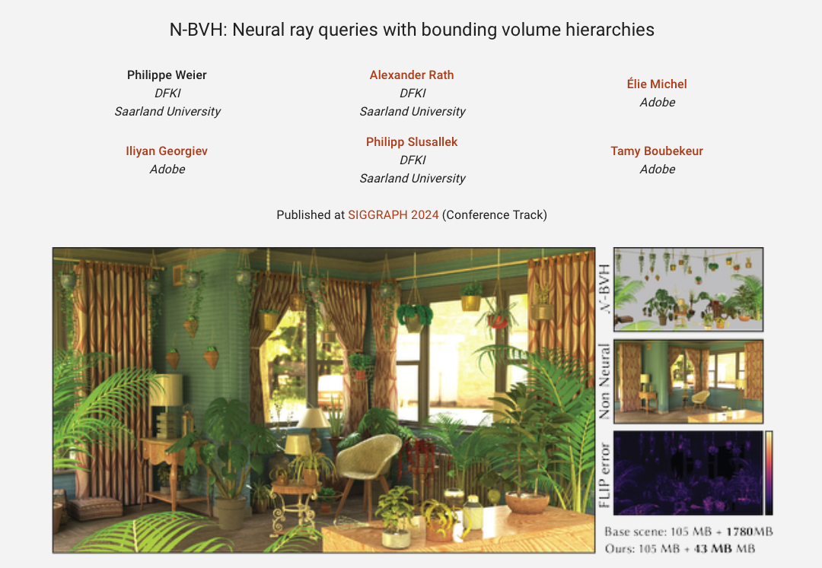
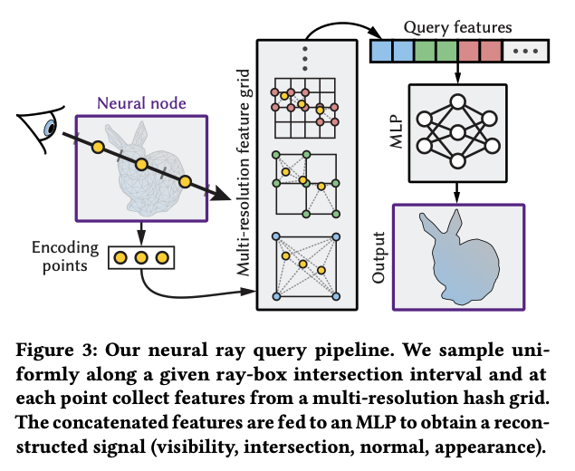
https://weiphil.github.io/portfolio/neural_bvh

Slide 58
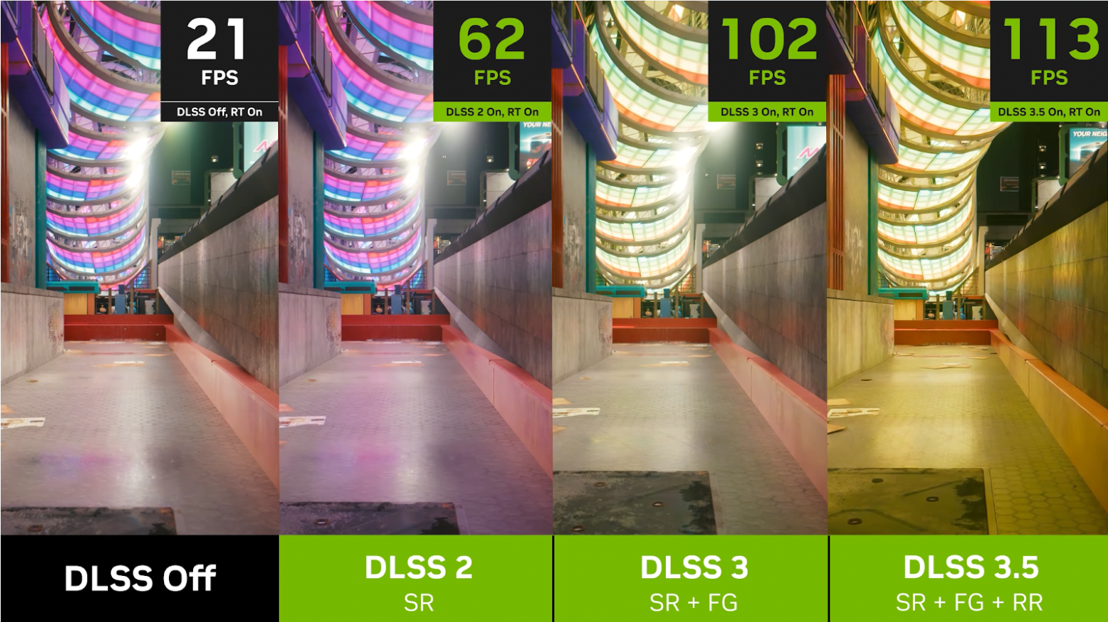
NVIDIA’s Deep-Learning Super Sampler (DLSS)
https://www.nvidia.com/en-gb/geforce/news/nvidia-dlss-3-5-ray-reconstruction/
https://www.youtube.com/watch?v=hr85Lc_WT38

