Slide 1
Computer Graphics Rendering
Lecture 14: Scattering media
Kartic Subr

Slide 2
CW1 marks

Slide 4
Recap: Sampling patterns

Slide 5
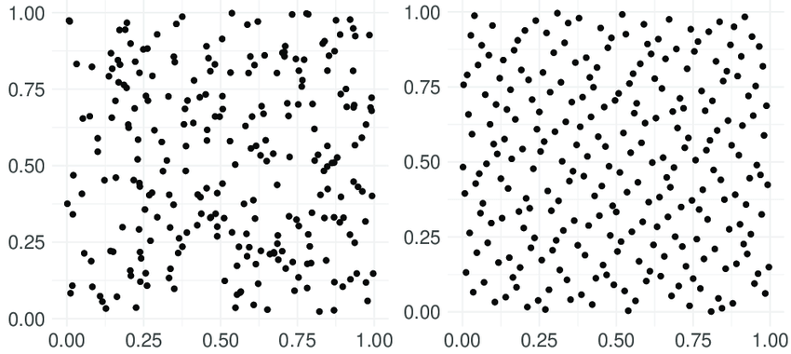
Sampling: Evaluate if a pattern is good

Slide 6
Sampling: Evaluate if a pattern is good

Slide 7
Discrepancy
https://en.wikipedia.org/wiki/Equidistributed_sequence#Discrepancy

Slide 8
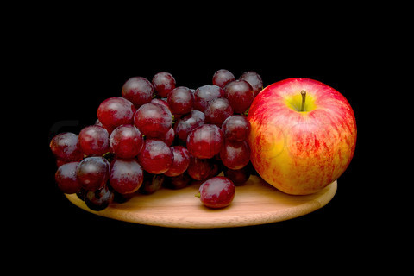
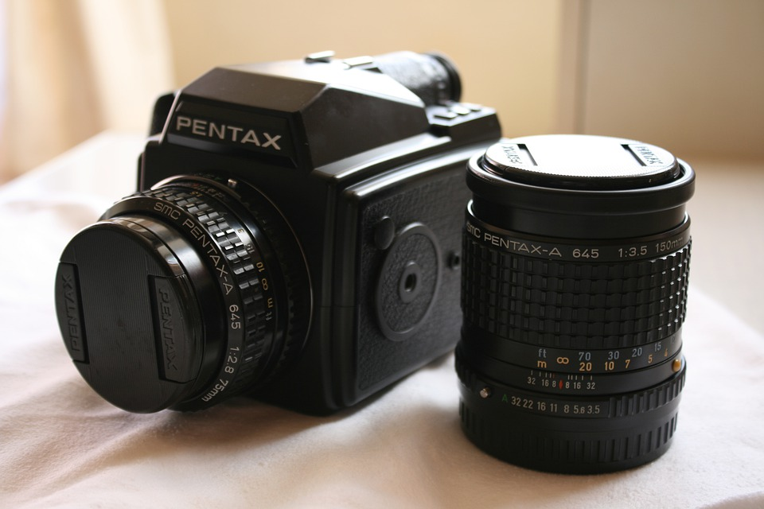
Displays
Radiance

Slide 9
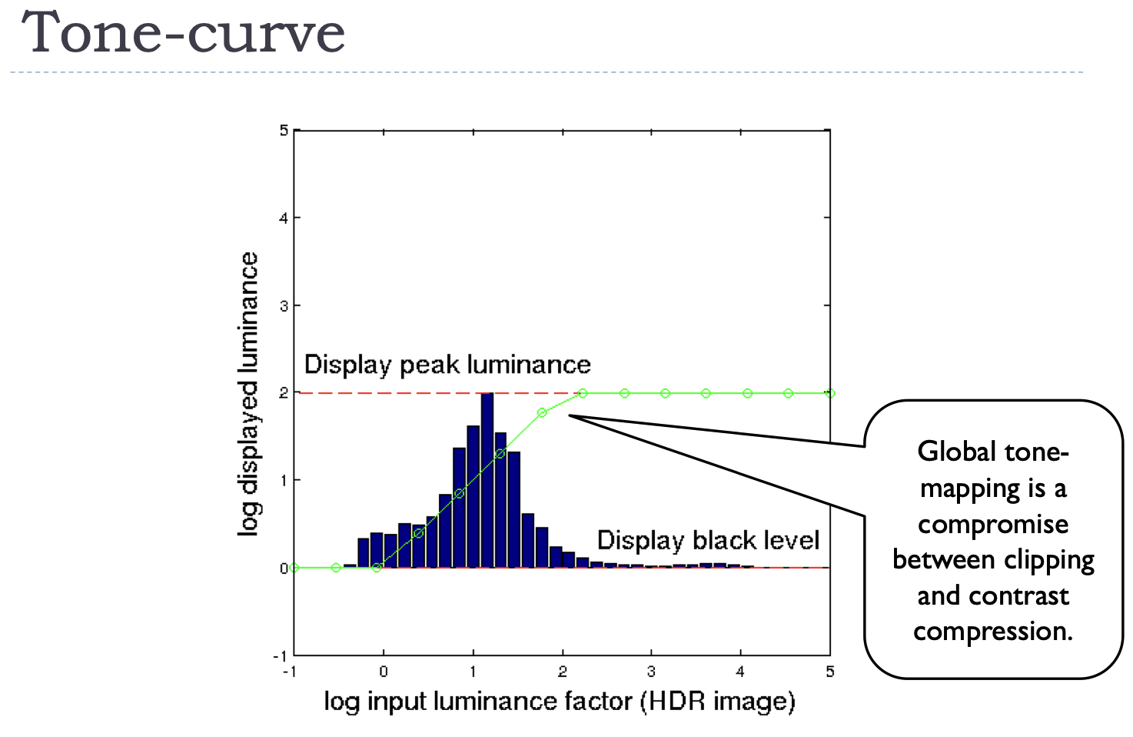
Global tone-mapping
https://www.cl.cam.ac.uk/teaching/1718/AdvGraph/06_HDR_and_tone_mapping.pdf

Slide 10
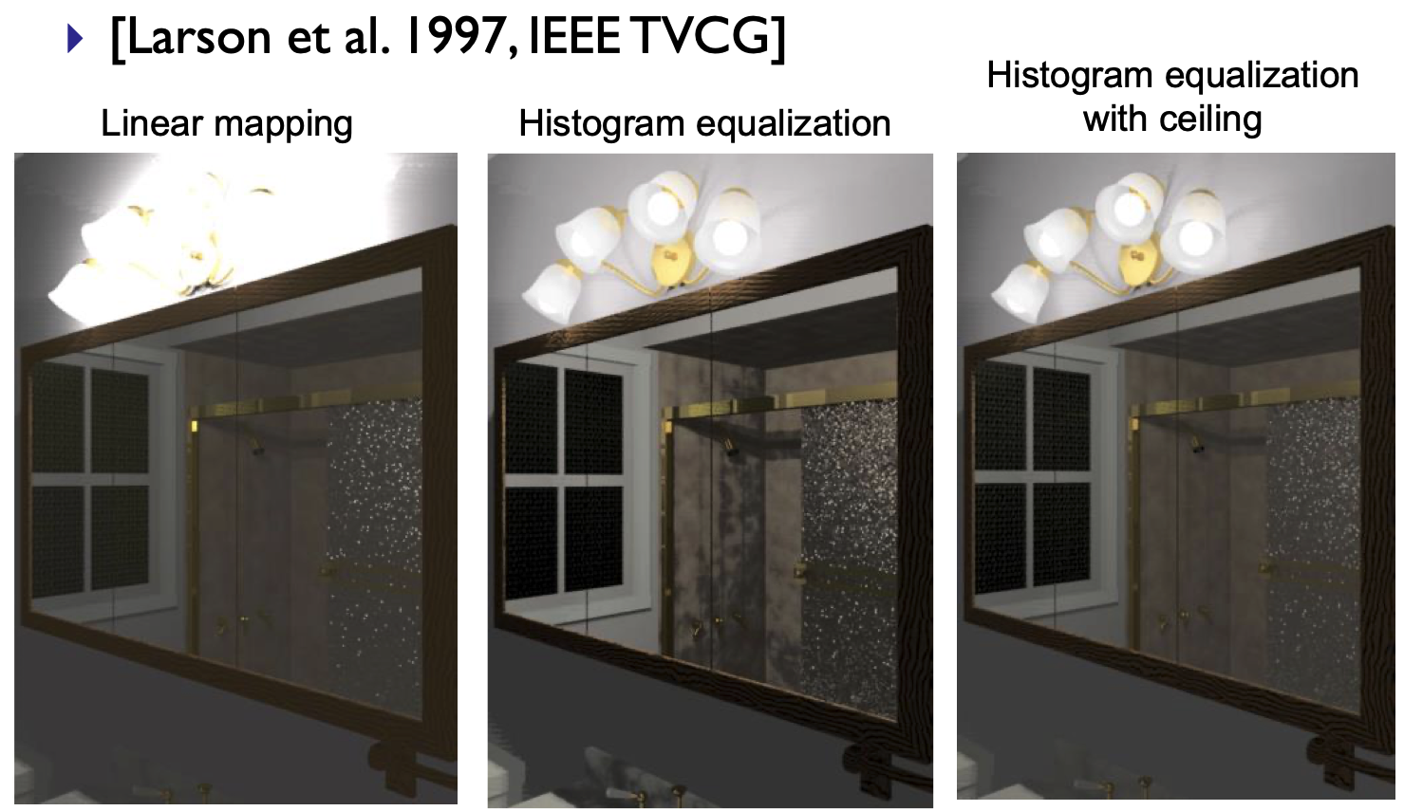
Histogram adjustment

Slide 11
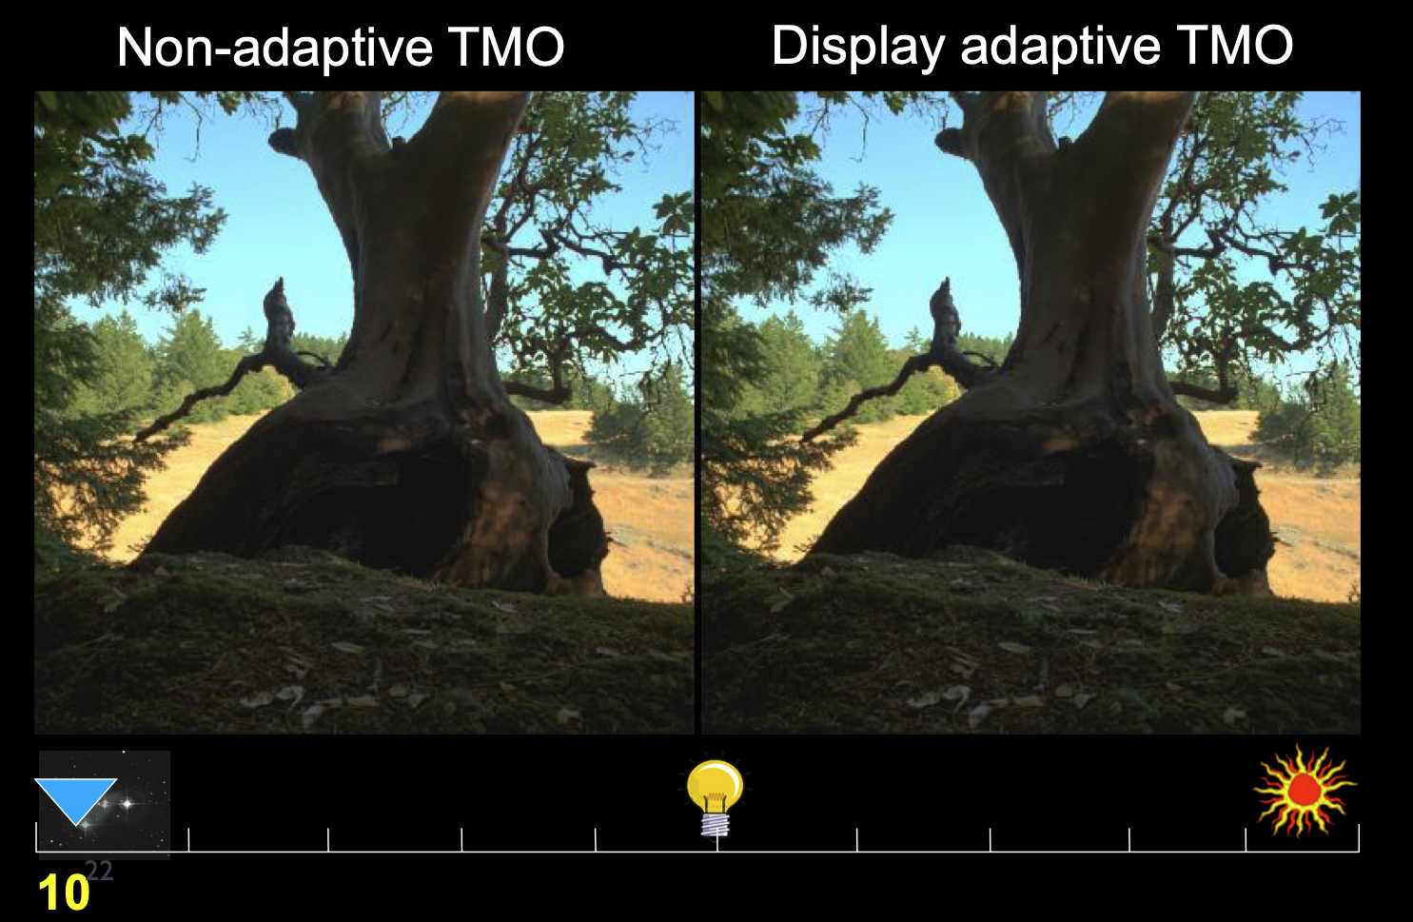

Slide 12
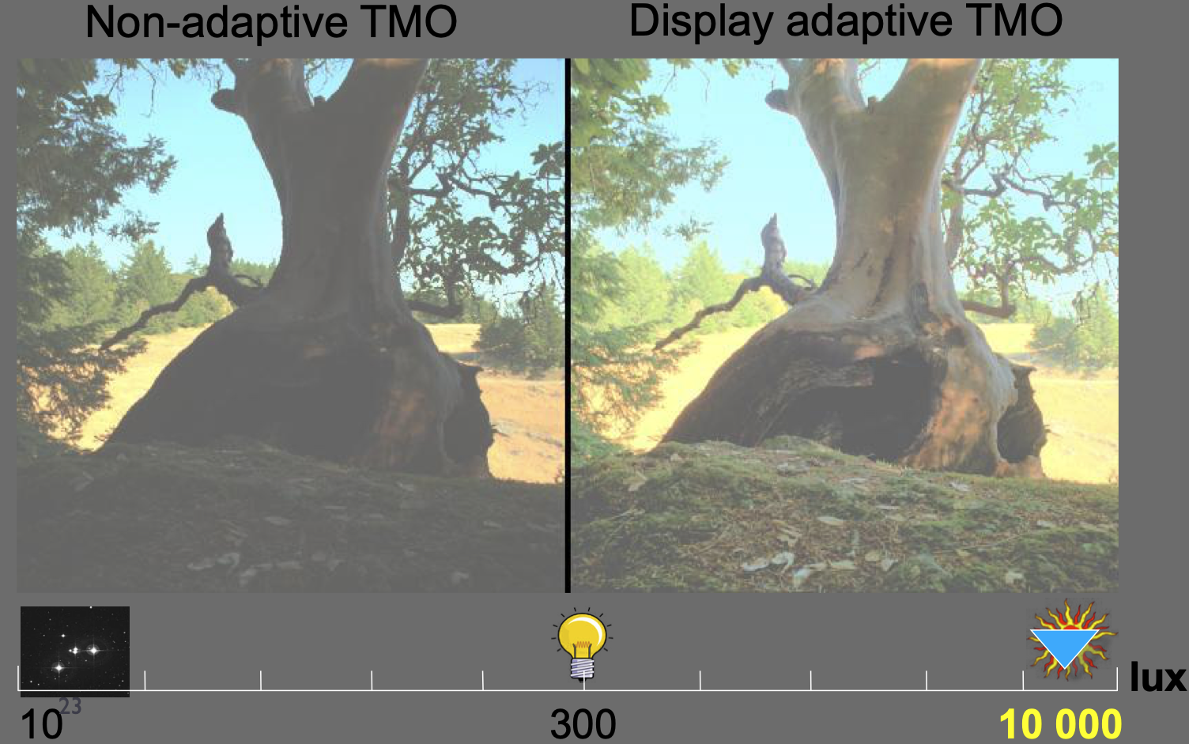

Slide 22
absorption
out-scatter
in-scatter
emission

Slide 23
Phase function

Slide 25
+
-

Slide 26
SIGGRAPH 2018 course slides
https://cs.dartmouth.edu/~wjarosz/publications/novak18monte-sig.html

Slide 27
Simplify calculations by adapting BRDFs?

Slide 28
Siggraph 2001
BRDF
BSSRDF
Full simulation

Slide 29
https://www.pbrt.org/scenes-v3

