Slide 1
Computer Graphics
Lecture 12: Sampling I
Kartic Subr

Slide 2
What is sampling?

Slide 3
Function reconstruction problem
$$f(x)$$
$$f_{s}(x)$$
$$f_{r}(x)$$

Slide 4
Interpolate samples using a fixed function g(x)
$$f(x)$$
$$g(x)$$
$$f_{s}(x)$$
$$f_{r}(x)$$

Slide 5
Convolution with a `reconstruction kernel’
$$f_{r} \left(x\right)= \int{f_{s}\left(x−y\right)g\left(y\right)dy}$$
$$=f_{s}⊗g$$
$$f(x)$$
$$g(x)$$
$$f_{s}(x)$$
$$f_{r}(x)$$

Slide 6
How to reduce reconstruction error?

Slide 7
Some preliminaries: this lecture

Slide 8
Dirac-Delta distribution
Notes:
\hat{f}(\omega) = \int\limits_{-\infty}^{\infty} f(x) e^{-2\pi \mathrm{\imath} \omega x} \mathrm{d}x
\hat{f}(\omega) = \int\limits_{-\infty}^{\infty} f(x) \cos ({2\pi \omega x}) \mathrm{d}x + \mathrm{\imath} \int\limits_{-\infty}^{\infty} f(x) \sin ({2\pi \omega x}) \mathrm{d}x

Slide 9
Dirac-Delta distribution
Zero everywhere else
Unit integral
Identity function for convolution
Notes:
\hat{f}(\omega) = \int\limits_{-\infty}^{\infty} f(x) e^{-2\pi \mathrm{\imath} \omega x} \mathrm{d}x
\hat{f}(\omega) = \int\limits_{-\infty}^{\infty} f(x) \cos ({2\pi \omega x}) \mathrm{d}x + \mathrm{\imath} \int\limits_{-\infty}^{\infty} f(x) \sin ({2\pi \omega x}) \mathrm{d}x

Slide 10
Recall: ‘Operate on’ a vector?
operator
a
b
u
au + bv
=
c
d
v
cu + dv

Slide 11
Which vector – unaffected by operator?
?
a
b
u
u
=
constant
c
d
v
v

Slide 12
Which vector – unaffected by operator?
a
b
u
u
=
constant
c
d
v
v
Eigenvector of matrix

Slide 13
Continuous - Eigenfunctions
Eigenfunction of differential operator?
$$\frac{d}{dx}$$

Slide 14
$$\frac{d}{dx}$$
$$f\left(x\right)=x$$
$$f\left(x\right)=k$$

Slide 15
Move out of my way. I’m a derivative operator!!
You can’t bully me. Meet your Eigenfunction. You won’t affect me!
$$e^{x}$$

Slide 16
HA! I am
$$\frac{d}{dy}$$
$$e^{x}$$

Slide 17
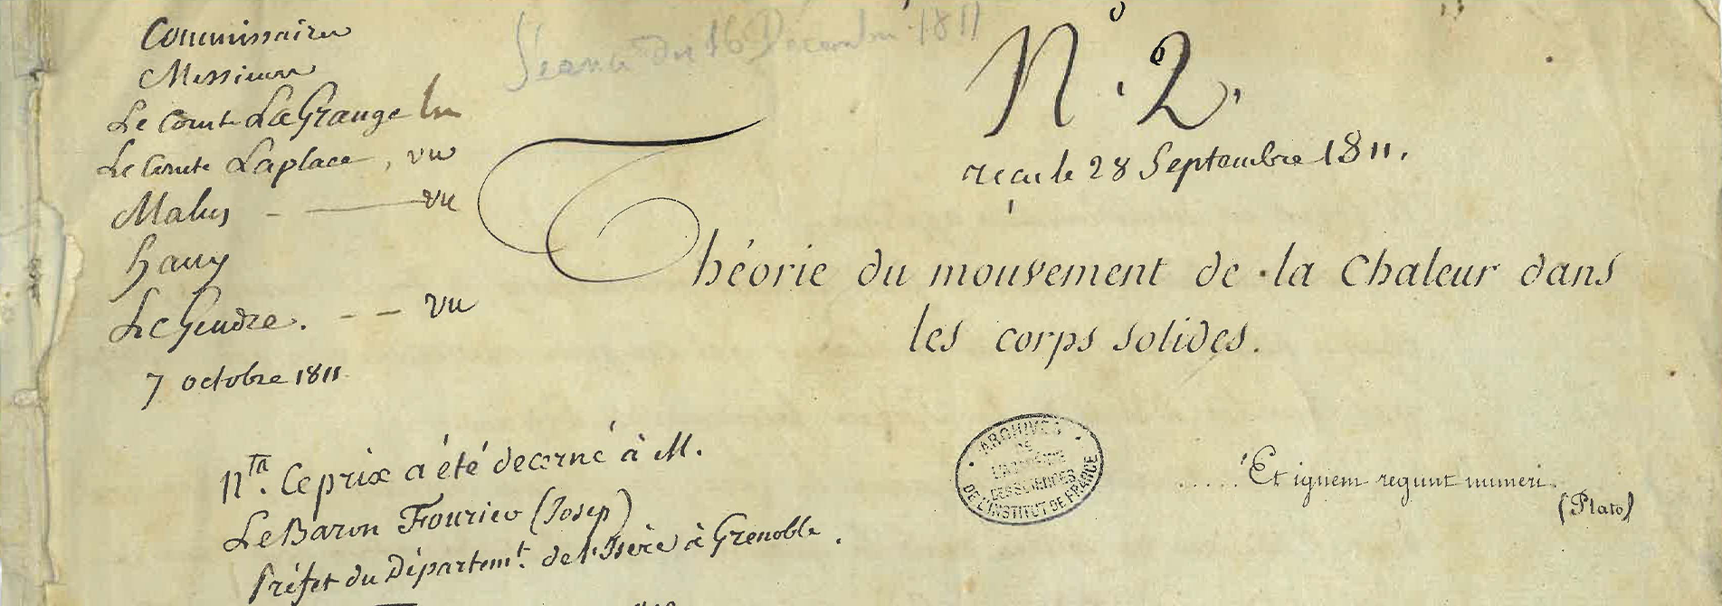
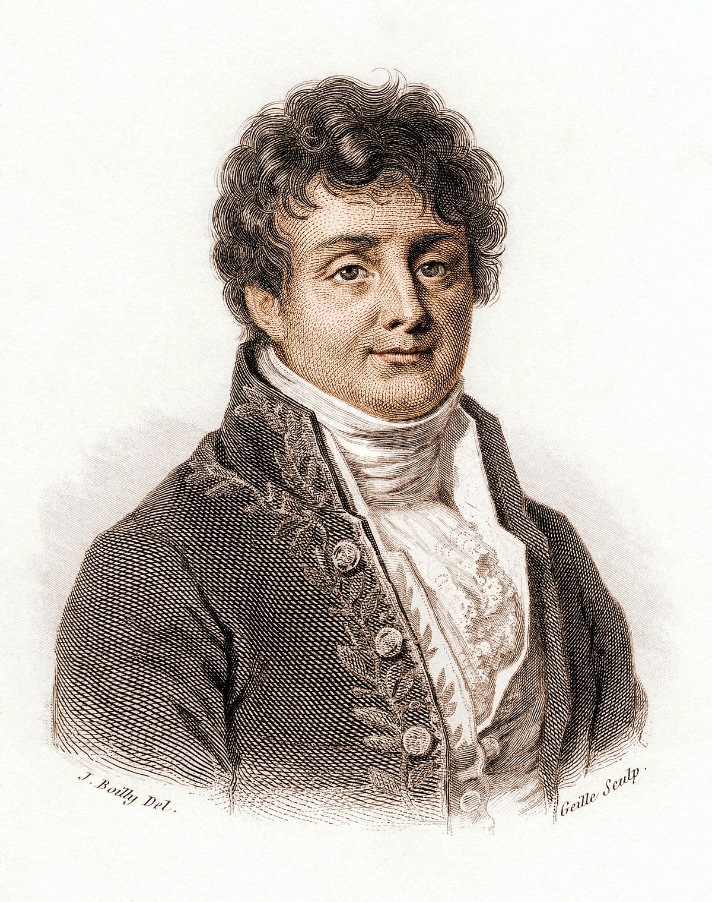
Fourier analysis: origin and intuition
Eigenfunction of the differential operator
scaling
Joseph Fourier, 1807
Notes:
\frac {\mathrm d} {\mathrm {d}x} e^{\lambda x} = \lambda e^{\lambda x}
f(x) = \sum\limits_{i=1}^N e^{\lambda_i x}, \quad \frac {\mathrm d} {\mathrm {d}x} f(x) = \sum\limits_{i=1}^N \lambda_i e^{\lambda_i x}

Slide 18
Use this to solve differential equations
Eigenfunction of the differential operator
differential equations -> algebraic equations
scaling
projection
Notes:
\frac {\mathrm d} {\mathrm {d}x} e^{\lambda x} = \lambda e^{\lambda x}
f(x) = \sum\limits_{i=1}^N e^{\lambda_i x}, \quad \frac {\mathrm d} {\mathrm {d}x} f(x) = \sum\limits_{i=1}^N \lambda_i e^{\lambda_i x}

Slide 19
If $λ$ is complex, then sinusoids …

Slide 20
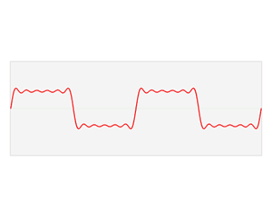
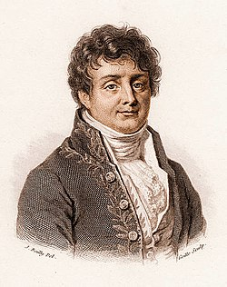
The Fourier domain
Image credits: Wikipedia
A special trigonometric series which could represent any arbitrary function
Notes:
\hat{f}(\omega) = \int\limits_{-\infty}^{\infty} f(x) e^{-2\pi \mathrm{\imath} \omega x} \mathrm{d}x

Slide 21
The continuous Fourier transform
Fourier
domain
primal
(space, time, etc.)
domain
Notes:
\hat{f}(\omega) = \int\limits_{-\infty}^{\infty} f(x) e^{-2\pi \mathrm{\imath} \omega x} \mathrm{d}x

Slide 22
The Fourier transform: `frequency’ domain
frequency
domain
frequency
projection onto sin and cos
Notes:
\hat{f}(\omega) = \int\limits_{-\infty}^{\infty} f(x) e^{-2\pi \mathrm{\imath} \omega x} \mathrm{d}x
\hat{f}(\omega) = \int\limits_{-\infty}^{\infty} f(x) \cos ({2\pi \omega x}) \mathrm{d}x + \mathrm{\imath} \int\limits_{-\infty}^{\infty} f(x) \sin ({2\pi \omega x}) \mathrm{d}x

Slide 23
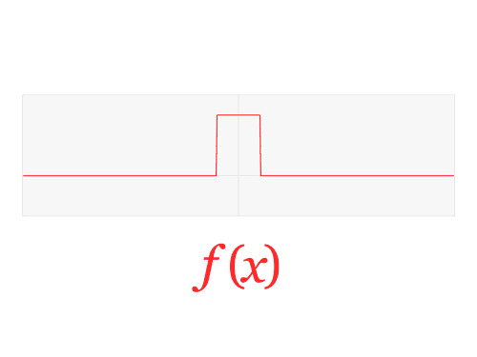
The Fourier Transform
high freq.
0
0
$$ξ$$
low-frequencies
$$x$$
high freq.

Slide 24
Fourier “duals”
$$f\left(x\right)$$
$$F\left(ξ\right)$$

Slide 25
What can you take the Fourier transform of?
xkcd.com

Slide 26
A single sample:
phase
amplitude = 1
frequency
Notes:
\hat{f}(\omega) = \int\limits_{-\infty}^{\infty} f(x) e^{-2\pi \mathrm{\imath} \omega x} \mathrm{d}x
\hat{f}(\omega) = \int\limits_{-\infty}^{\infty} f(x) \cos ({2\pi \omega x}) \mathrm{d}x + \mathrm{\imath} \int\limits_{-\infty}^{\infty} f(x) \sin ({2\pi \omega x}) \mathrm{d}x

Slide 27
sampling function = sum of Dirac deltas
+
+
+
Notes:
Any unweighted, sampling function can be expressed as the sum of impulses (or Dirac delta functions).

Slide 28
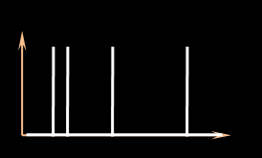
Fourier spectrum of the sampling function
sampling function
amplitude (sampling spectrum)
frequency
phase (sampling spectrum)
Notes:
To abstract away these approaches, we analyse the estimators based on the signature of the sampling function in the Fourier domain. eg. This plot shows the amplitude (yellow) and phase (blue) of the sampling signal.

Slide 29
In the Fourier domain …
Fourier transform
Dirac delta
Frequency
Imaginary
amplitude
phase
Real
primal
Fourier
Complex plane
Notes:
The Fourier transform of a Dirac delta function is a constant (amplitude) with a phase that is linear in frequency (before the modulo 2pi)

Slide 30
Review: in the Fourier domain …
Fourier transform
Dirac delta
Frequency
Imaginary
Imaginary
Real
Real
primal
Fourier
Complex plane
Complex plane
Notes:
The Fourier transform of a Dirac delta function is a constant (amplitude) with a phase that is linear in frequency (before the modulo 2pi)

Slide 31
Remember convolution?
$$h\left(x\right)= \int{f\left(x−y\right)g\left(y\right)dy}$$
$$h\left(x\right)= f\left(x\right)⊗g(x)$$
$$g$$
$$f$$
$$h$$

Slide 32
Fourier Transform of Convolution ?
$$h\left(x\right)= f\left(x\right)⊗g(x)$$
$$g$$
$$f$$
$$h\left(x\right)= \int{f\left(x−y\right)g\left(y\right)dy}$$
$$h$$

Slide 33
Fourier Transform of Convolution ?
$$h\left(x\right)= f\left(x\right)⊗g(x)$$
$$g$$
$$ℱ(h\left(x\right))=ℱ(f\left(x\right)⊗g\left(x\right))$$
$$f$$
$$h\left(x\right)= \int{f\left(x−y\right)g\left(y\right)dy}$$
$$h$$

Slide 34
Fourier Transform of Convolution ?
$$h\left(x\right)= f\left(x\right)⊗g(x)$$
$$g$$
$$ℱ(h\left(x\right))=ℱ(f\left(x\right)⊗g\left(x\right))$$
$$f$$
$$H\left(ξ\right)=F\left(ξ\right) G\left(ξ\right)$$
$$h\left(x\right)= \int{f\left(x−y\right)g\left(y\right)dy}$$
$$h$$

Slide 35
Convolution theorem
$$ℱ\left(f\left(x\right)⊗g\left(x\right)\right)=F\left(ξ\right) G\left(ξ\right)$$
Fourier transform of a convolution
product of Fourier transformed functions
$$h\left(x\right)= \int{f\left(x−y\right)g\left(y\right)dy}$$

Slide 36
Alternative way to calculate convolutions
$$h\left(x\right)= \int{f\left(x−y\right)g\left(y\right)dy}$$
Fast Fourier Transform
Obtain Fourier transforms F and G
Multiply, so H = F.G
Take the inverse Fourier transform of H
h = H⁻¹
Fast Fourier Transform

Slide 37
What if we apply the Fourier transform?
$$f_{r} \left(x\right)= \int{f_{s}\left(x−y\right)g\left(y\right)dy}$$
$$=f_{s}⊗g$$
$$f(x)$$
$$F_{r}(ξ) =F_{s}(ξ) G(ξ)$$
$$g(x)$$
$$f_{s}(x)$$
$$f_{r}(x)$$

Slide 38
How to assess sampling and reconstruction error?

Slide 39
Focus on the sampling operation first:
$$f(x)$$
$$f_{s}\left(x\right)$$
$$x$$
multiply

Slide 40
What are these in the Fourier domain?
$$f(x)$$
$$f_{s}\left(x\right)$$
$$x$$
convolve

Slide 41
Intuition: Sampling function
$$F_{s}\left(ξ\right)$$
$$f_{s}\left(x\right)$$
$$x$$
$$ξ$$

Slide 42
Intuition: Sampling function
$$F_{s}\left(ξ\right)$$
$$f_{s}\left(x\right)$$
$$x$$
$$ξ$$

Slide 43
Sampling in the Fourier Domain
$$f(x)$$
$$f_{s}\left(x\right)$$
$$x$$
convolve

Slide 44
How to remove aliases?
convolve
multiply Fourier spectrum by box

Slide 45
Sparse sampling (squeezed in Fourier domain)
convolve

Slide 46
Sparse sampling (squeezed in Fourier domain)
convolve
aliasing

Slide 47
Nyquist-Shannon Sampling theorem

Slide 48
Multiplication by a box in the Fourier (frequency) domain…
-B
B
-4B
-2B
2B
4B
convolve
multiply Fourier spectrum by box

Slide 49
... convolution with a reconstruction kernel (in x)
-B
B
-4B
-2B
2B
4B
convolve
multiply Fourier spectrum by box
convolve with kernel g(x)

Slide 50
Is a convolution with a reconstruction kernel (in the primal, or x)
-B
B
-4B
-2B
2B
4B
convolve
multiply Fourier spectrum by box
Find kernel whose Fourier spectrum best matches this box
convolve with kernel g(x)

Slide 51
To be continued …

