Slide 1
Computer Graphics
Lecture 6: Raytracing - advanced
Kartic Subr

Slide 2
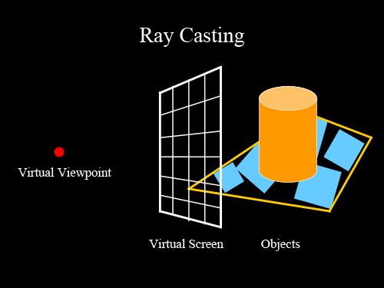
Recap

Slide 3
Recap
for each pixel p
trace ray
shade hit point

Slide 4
Shading
diffuse reflection
ambient light
specular reflection
final shading

Slide 5
Phong shading
material property
ambient
diffuse
specular
light property
R is the mirror reflection direction
source:wikipedia

Slide 6
How to deal with texture?

Slide 7
How to deal with texture?
object space
texture space
mapping
texture coordinates

Slide 8
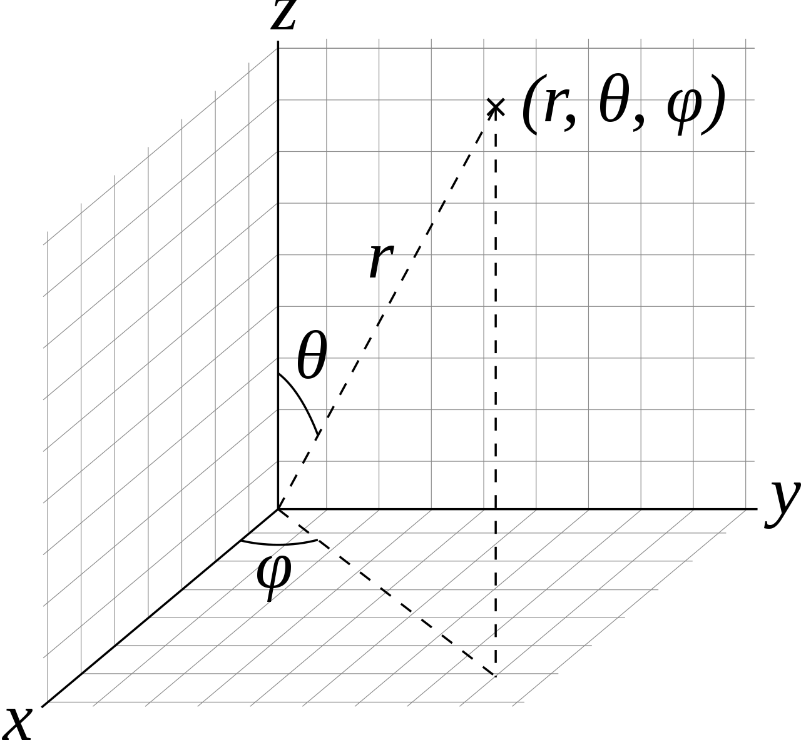
Texture coordinates on a sphere

Slide 10
Problems
How to generate maps?
Finite resolution
Artifacts
More later!
http://www.cemyuksel.com/courses/conferences/siggraph2017-rethinking_texture_mapping/rethinking_texture_mapping_course_notes.pdf

Slide 11
What’s wrong with this image?

Slide 12
Does not have any blur!

Slide 13
What causes blur?

Slide 14
A step function (edge)
pixel value
255
0
image

Slide 15
A blurred step function
pixel value
255
0
image

Slide 16
Fundamental operation?
255
255
?
0
0

Slide 17
Example: photo of a car
slice in y
f(x)

Slide 18
Example: motion blur

Slide 19
Example: slice is a 1D function
f(x)
space (x)

Slide 20
Example: add time as second dimension
time (t)
space (x)

Slide 21
Example: stationary car
time (t)
space (x)

Slide 22
Example: car moving to the right
time (t)
space (x)

Slide 23
Example: sum of shifted positions
space (x)

Slide 24
Example: motion blur
space (x)

Slide 25
Sums of shifted functions!
f(x)
255
+
f(x-t₁)
0
+
f(x-t₂)
…

Slide 26
Can you spot the “shifted sums” in each case?

Slide 27
Soft shadow due to area light

Slide 28
Example: Area light
light

Slide 29
Example: Area light
point light

Slide 30
Area light: integrate over angle
light

Slide 31
Sums of shifted functions!
f(x)
255
+
f(x-t₁)
0
+
f(x-t₂)
…

Slide 32
Sums of weighted, shifted functions!

Slide 33
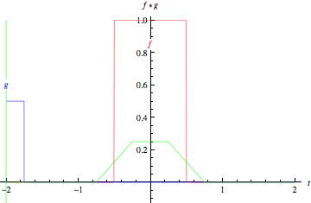
Sums of weighted, shifted functions!
wikipedia

Slide 34
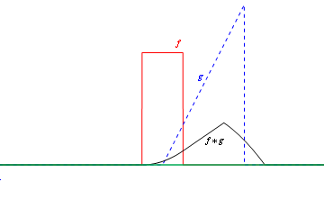
Sums of weighted, shifted functions!

Slide 35
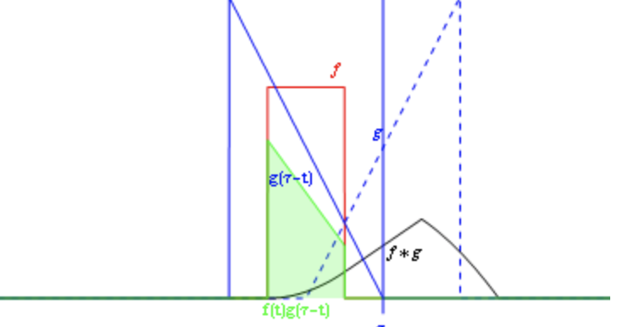
1D convolution

Slide 36
Sums of weighted, shifted functions!

Slide 37
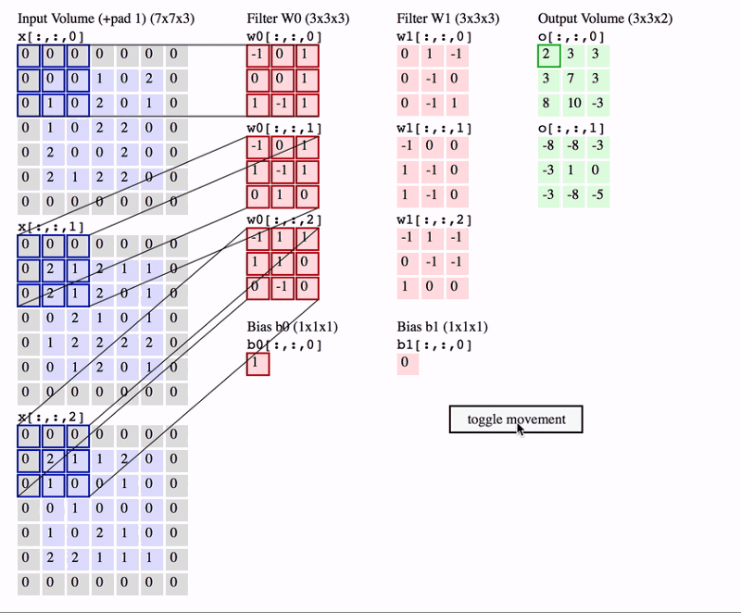
2D convolution
https://www.freecodecamp.org/news/an-intuitive-guide-to-convolutional-neural-networks-260c2de0a050/

Slide 38
Blurring due to integrals in rendering
area lights
camera lens
camera shutter, exposure time
wavelength (colour spectrum)
gloss (reflectance)
translucent objects

